Slide 2
INTRODUCTIONS
Welcome to our first AP Statistics Virtual Instruction Session!!
Presenters:
Brendan Murphy
John Bapst Memorial High School
Bangor, ME
Luke Wilcox
East Kentwood High School
Kentwood, MI
www.statsmedic.com/youtube

Slide 3
HOMEWORK REVIEW

Slide 5
WHAT YOU NEED TO KNOW
CHI SQUARE
Just Hypothesis Tests – No Confidence Intervals
Just one formula for this whole unit
This formula is on the College Board Formula Sheet included on the AP Statistics Exam.
Chi-Square is a nonparametric test meaning we do not make any assumptions about the underlying distribution (i.e. a normal distribution).

Slide 6
WHAT YOU NEED TO KNOW
THREE DIFFERENT CHI SQUARE TESTS
Chi Square Test for Goodness of Fit (GOF)-We compare our data to a “model” (many times these models have percentages and we need to remember to convert these percentages to “counts”)
Chi Square Test for Homogeneity- Compare two different populations, one variable
Chi Square Test for Independence-We have one population and want to compare two or more variables
We need to calculate df’s (degrees of freedom similar to what you did with means).
We need to check conditions:
Data was randomly selected from the population
All expected values are at least 5
10% Condition: Our population is at least 10 times our sample size

Slide 7
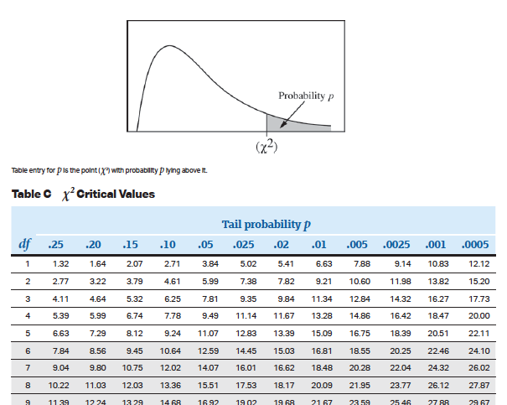
WHAT YOU NEED TO KNOW
A Chi Square table will be included in the formula sheet / table component of the AP Statistics Exam. Our calculators can “perform” these inference tests and students are expected to know how to access and use these tests on the AP Statistics Exam.

Slide 9
Chi Square Test for Independence
Chi Square Test for Independence:
Data comes from a SINGLE random sample from a population
We have two or more categorical variables that we are interested in seeing if they are “related”
Typically data is shown in a two-way table
df= (rows-1)(columns-1)=(r-1)(c-1)
Calculating Expected Values (row total)(column total)/(total)
We can use our calculators to get these Expected Values but it could be faster/easier to use the formula above (see tonight’s HW later in this presentation)

Slide 10
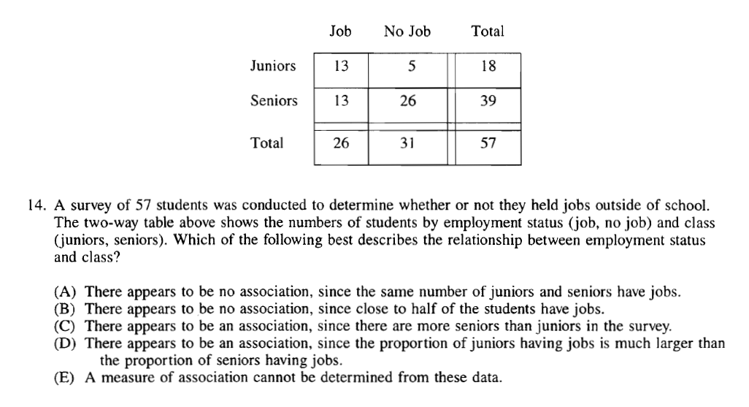
Chi Square Test for Independence-1997 MC #14

Slide 12
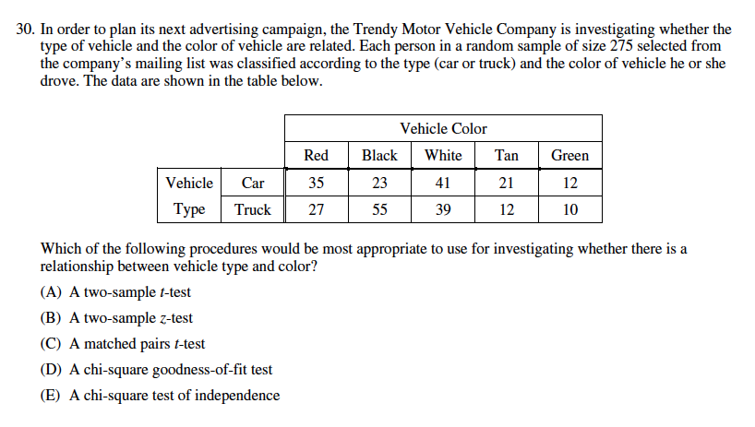
GUIDED PRACTICE
2012 Multiple Choice Question #30

Slide 13
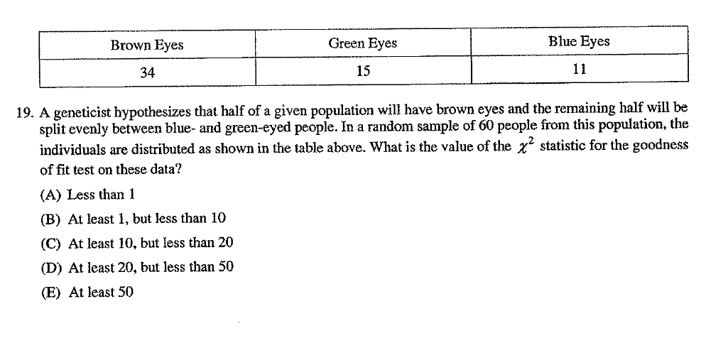
GUIDED PRACTICE
2002 Multiple Choice Question #19

Slide 15
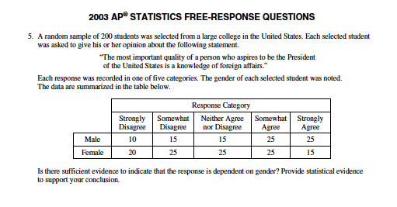
2003 AP Statistics #5

Slide 16
Statistical Inference Steps
We first want to name the Inference Test we are using and then think about these four steps:
Chi Square Test for Independence
State Ho, Ha, and identify the parameter
List assumptions and check conditions
Mechanics/Math
Conclusion in context

Slide 17
Let’s write out the null and alternative hypothesis
Ho: The response to this quote and gender are independent
Ha: The response to this quote and gender and not independent
Or
Ho: There is no association between the response to this quote and gender
Ha: There is an association between the response to this quote and gender

Slide 18
Let’s check conditions and list assumptions and list out the math/mechanics
Data was selected randomly as stated in the stem of the problem
We can assume the population of students at this large college is greater than 2000 students (population > 10 * sample size)
All expected counts are greater than 5 (you should show all of these expected values that we get from our calculator somewhere on your test/answer sheet)
df= (2-1)(5-1)= 4 or you can list this number which the calculator gives us
Chi Square Statistic (insert symbol)=8.922
P value= .063
These three lines are sufficient for the mechanics/math assuming students have named the test somewhere in their answer.

Slide 19
State our conclusion in context, specific to this problem
Since our p value of .063> our assumed significance level alpha=.05, we fail to reject the null hypothesis (this sentence is somewhat generic and does not address include any specific context to “our problem”). There is not sufficient evidence to to conclude that the response to this quotation is dependent on gender.
Of course there are many other ways to summarize this answer and each teacher tends to have their own way to teach how to summarize their answers.

Slide 20
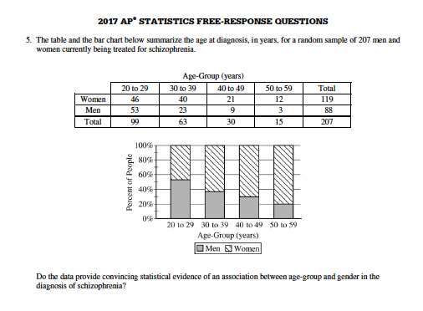
2017 FRQ #5

Slide 21
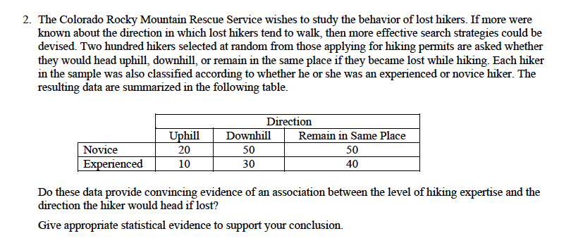
1999 FRQ #2

Slide 23
DEBRIEF AND SUMMARY
Hopefully by now you are feeling more comfortable with the Chi Square Tests
You should be able to select and use the correct Chi Square Test
Similar to other Inference Tests/Procedures you should be able to write a clear/concise solution in context

Slide 24
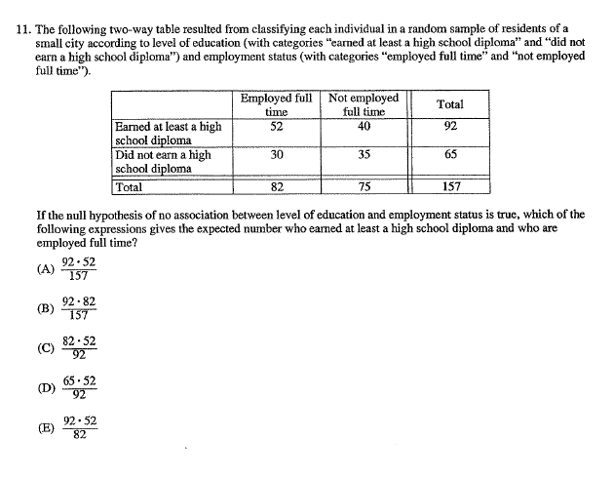
2002 MC #11 Homework Problem Monday 03/30

Slide 25
Device and Internet Access
We know that not all students have access to the internet or a device. We’re working on solutions to help students get what they need to show their best work. If you need mobile tools or connectivity or know someone who does, you can reach us directly to let us know.
cb.org/tech

