Slide 1
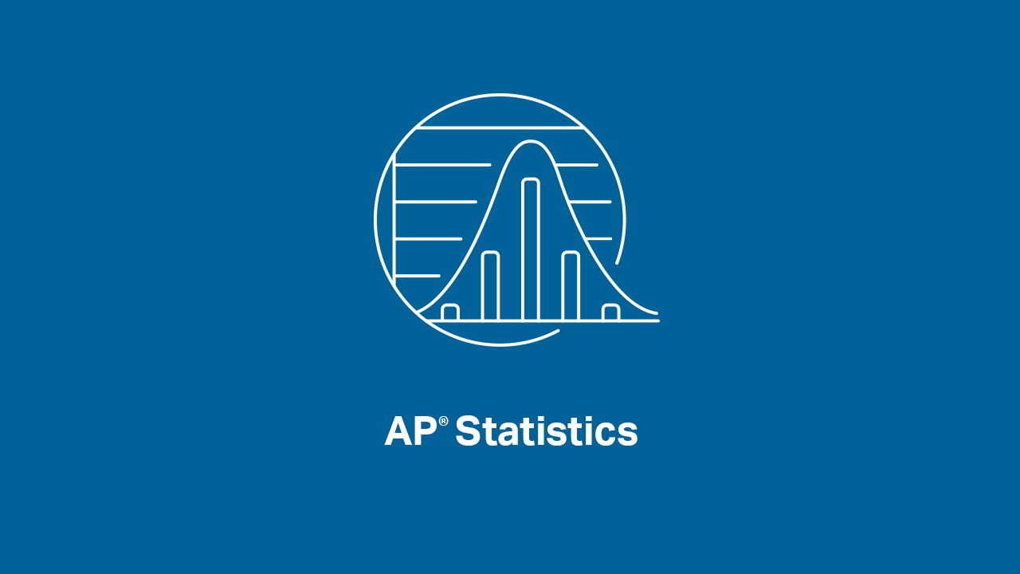

Slide 2
INTRODUCTIONS
Presenters:
Brendan Murphy
John Bapst Memorial High School
Bangor, ME
Luke Wilcox
East Kentwood High School
Kentwood, MI
www.statsmedic.com/youtube

Slide 3
HOMEWORK REVIEW - 2002 Multiple Choice #24 Homework Problem Wednesday 04/29

Slide 4
UPDATES FOR STUDENTS/TEACHERS
http://collegeboard.org/ap-covid19-updates
https://apstudents.collegeboard.org/coronavirus-updates
https://apcoronavirusupdates.collegeboard.org/educators/course-schedule
Scroll down to Math And Science, click on AP Statistics, Expand All

Slide 5
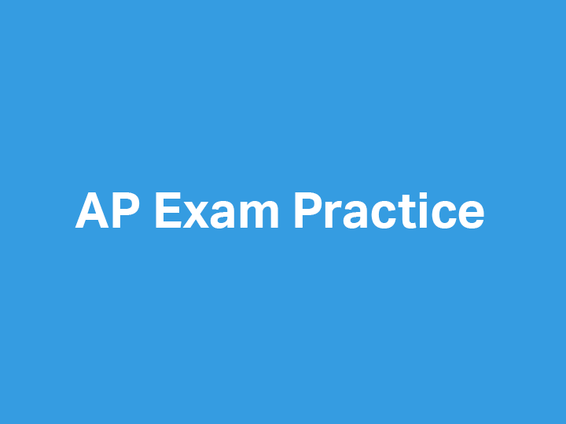

Slide 6
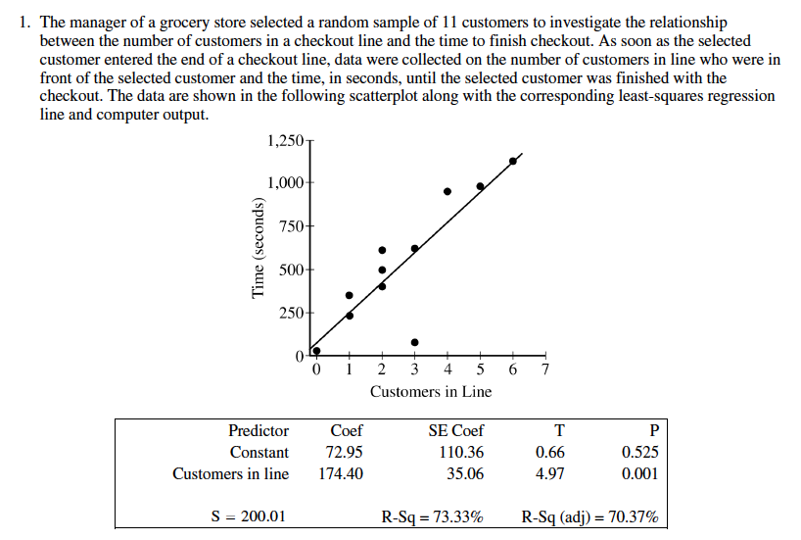
2018 AP Statistics – Free Response #1 (Modified)

Slide 7
2018 - AP Statistics Free Response #1 Modified (continued)
What is the equation of the least-squares regression line? Identify your variables.
Identify and interpret in context the estimate for the intercept of the least-squares regression line.
Interpret in context the slope of the least-squares regression line.
Identify and interpret in context the coefficient of determination, r^2
Calculate and interpret in context the correlation coefficient, r.
One of the data points was determined to be an outlier. Circle the point on the scatterplot and explain why the point is considered an outlier.
Interpret in context the meaning of the point (outlier) you circled in part f.
Calculate/estimate the residual for the point (outlier) t you circled in part f.

Slide 8
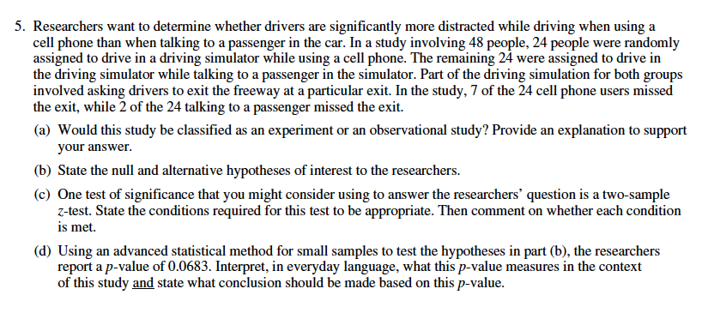
2007 - AP Statistics Free Response #5

Slide 9
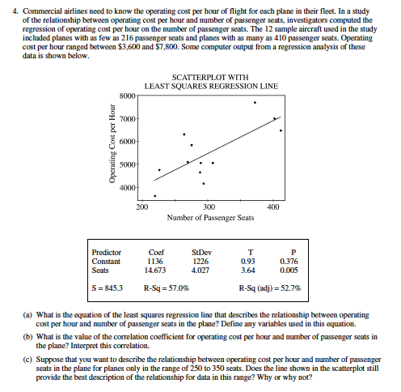
2002 - AP Statistics Free Response #4

Slide 11
DEBRIEF AND SUMMARY
Hopefully by now you are feeling more comfortable with FRQ’s that address more than one major theme/thread and perhaps more parts than typical FRQ’s. We will practice these modified/longer FRQ’s next week
Similar to all problems in AP Statistics you should be able to write a clear/concise solution in context

Slide 12
2002 Multiple Choice #37 Homework Problem Friday 05/01

Slide 13
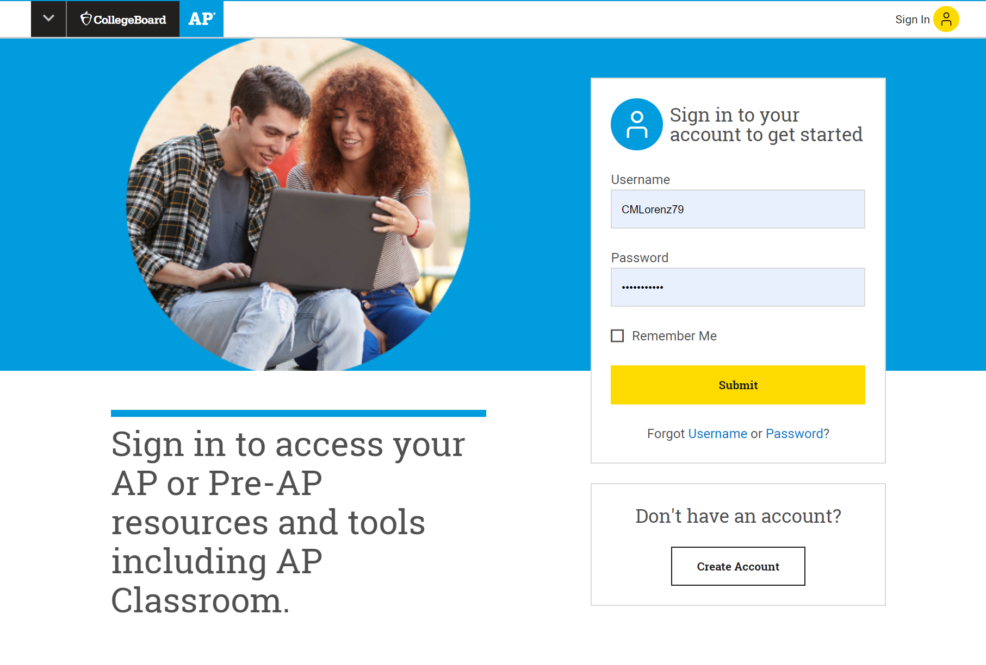
Log in at: myap.collegeboard.org

Slide 14
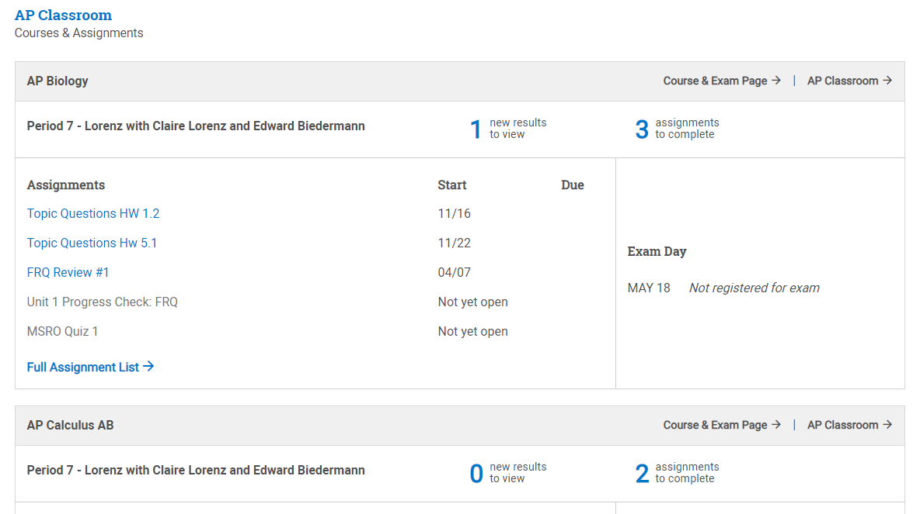
Scroll to see your classes and access AP Classroom
Click here

Slide 15
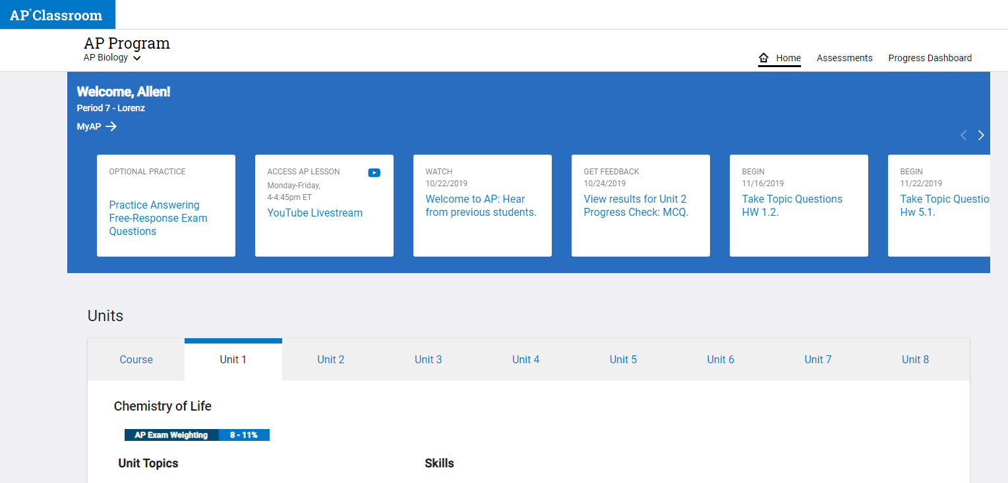
Click to access AP Live classes or Optional Practice
Click here AP Live classes on YouTube
Click here for Optional Student Practice

Slide 16
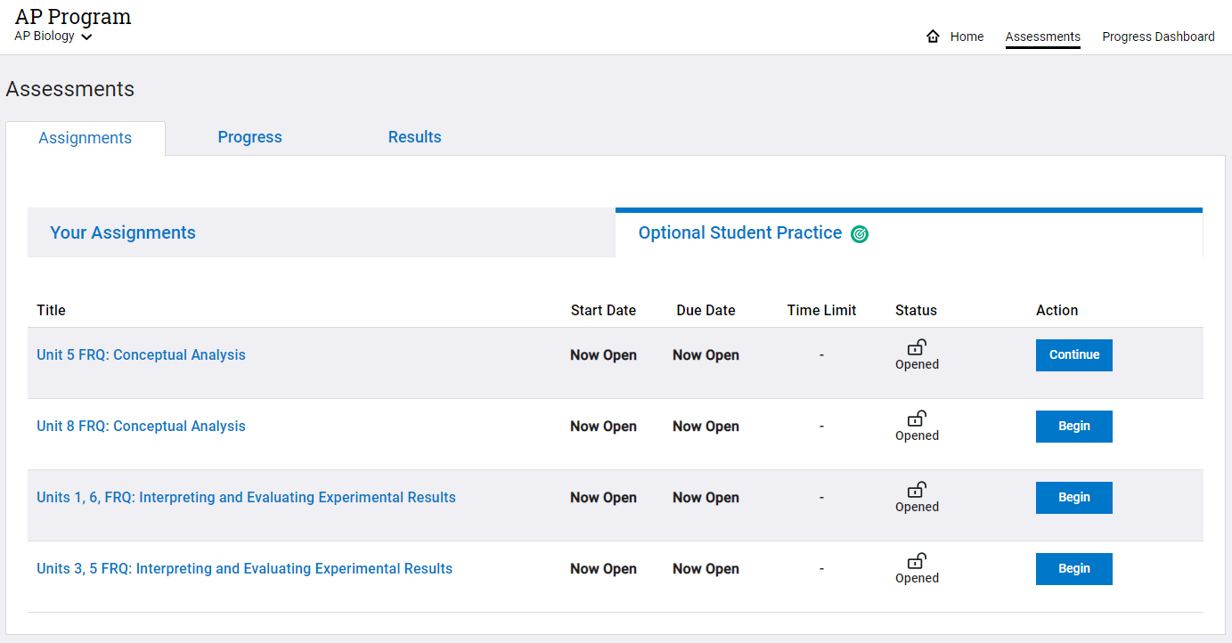
Click Begin or Continue to start a question
Click here
Click here

Slide 17
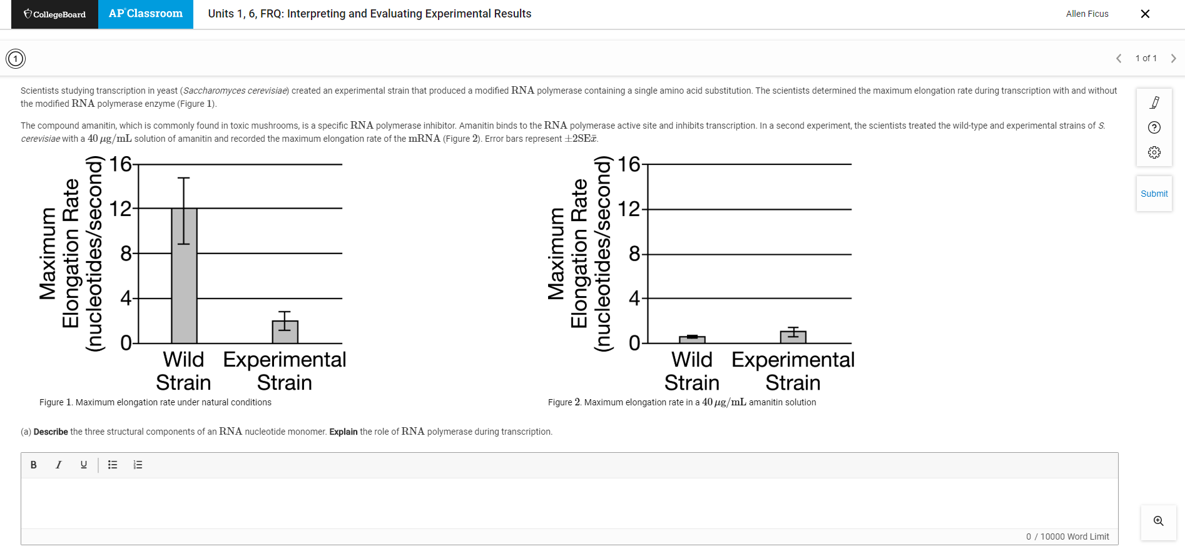
Type or upload your response. Then, click Submit.
Click submit when you are finished
Enter your response here

Slide 18
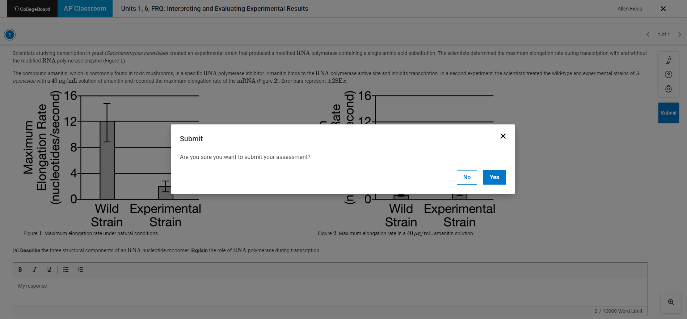
Click Yes to continue to submit your response

Slide 19
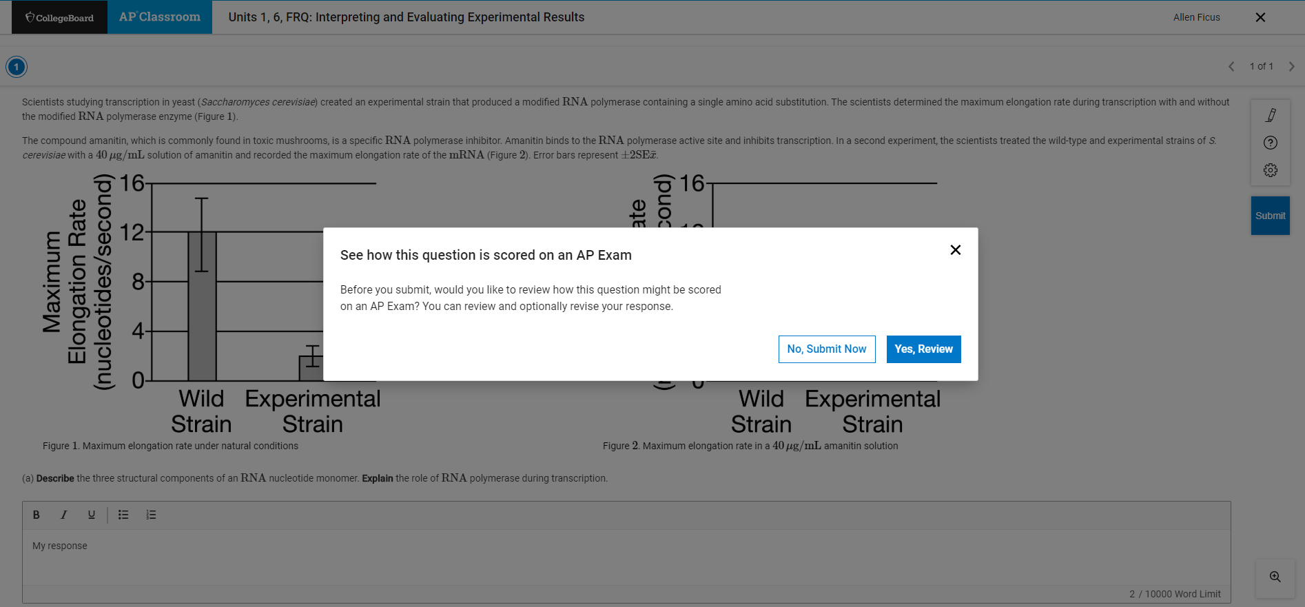
Click Yes, Review to see Scoring Guidelines

Slide 20
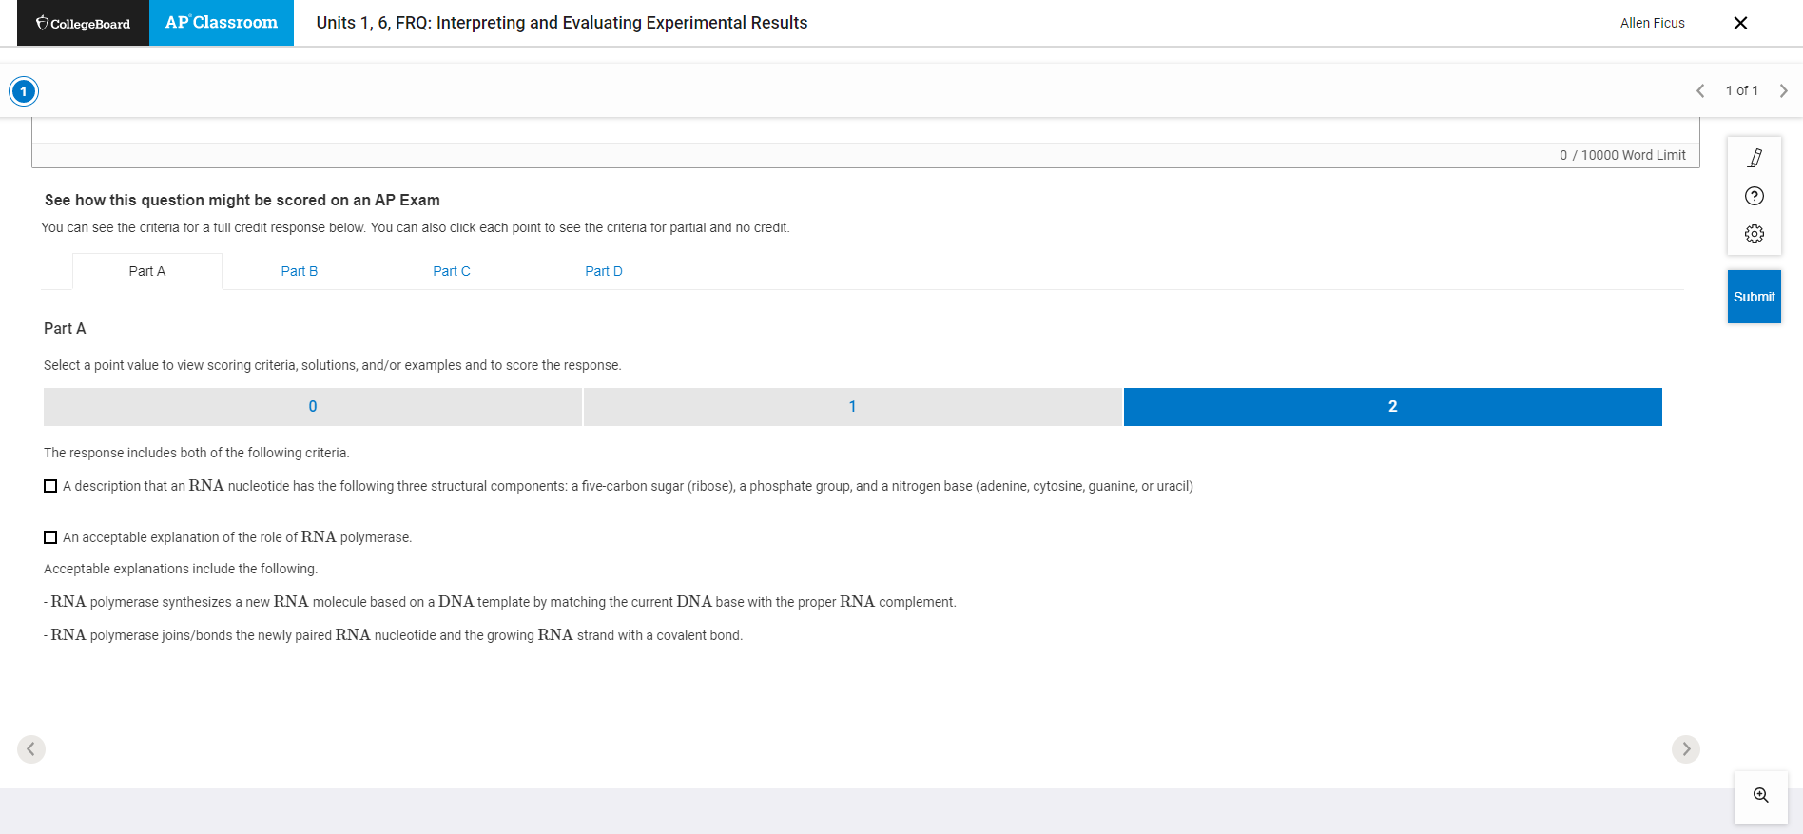
Scroll down to see Scoring Guidelines for each part
Review to see examples of what a response should include to earn the maximum number of points

Slide 21
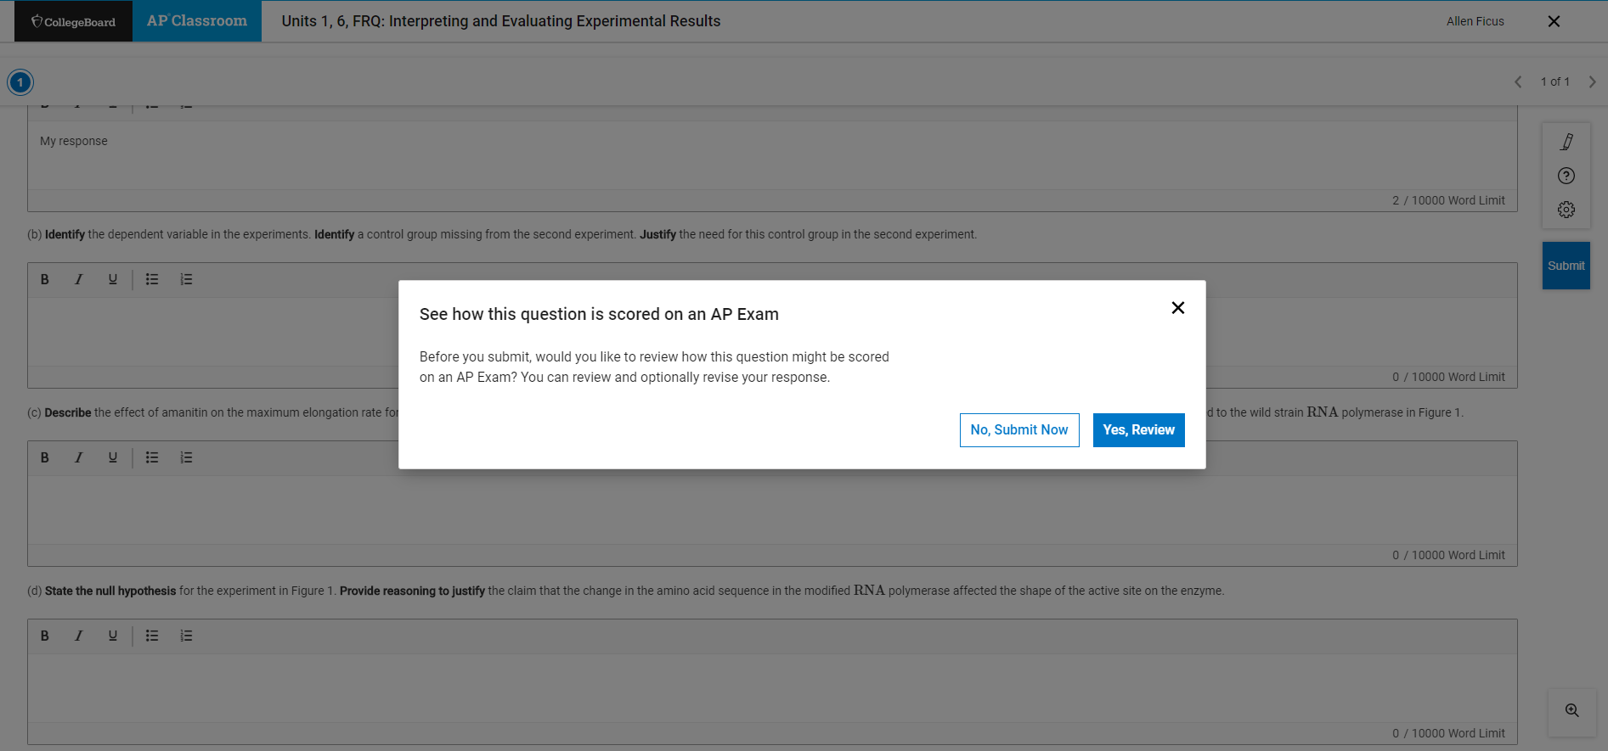
Revise, then click Submit & No, Submit Now to finish

