Slide 1
STATS AND THE SAT
Lindsey Gallas And Luke Wilcox
East Kentwood High School
www.StatsMedic.com/CALVIN2019

Slide 2
LINDSEY OR LUKE?
Can identify 126 types of cheeses.
Has been to 126 Phish concerts.
Is a coffee snob.
Once shipped a car to Iceland.
Would win in a game of “Hoop Fever”.
Teaches at East Kentwood High School.

Slide 3
TWO Activities
(1) The Last Banana
(2) Can You Taco Tongue and Evil Eyebrow?

Slide 4
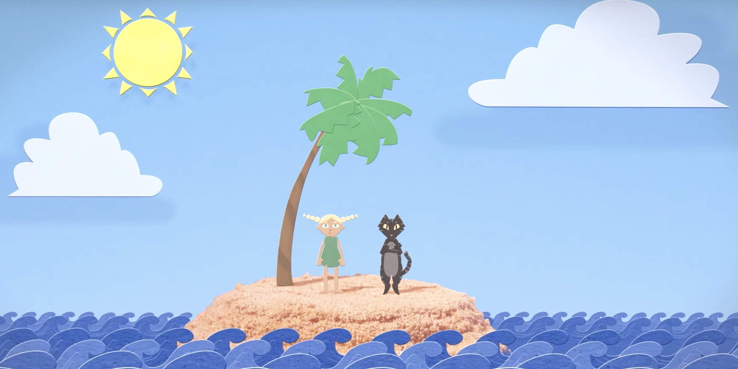
The Last Banana

Slide 5
www.tinyurl.com/CALVINtacotongue

Slide 6
Summary
How were these lessons different from a traditional math lesson?

Slide 7
Experience First, Formalize Later
Engaging context
Address learning targets
Low floor, high ceiling
Math dial
Scaffolding and linking questions
Concrete to conceptual

