Slide 1
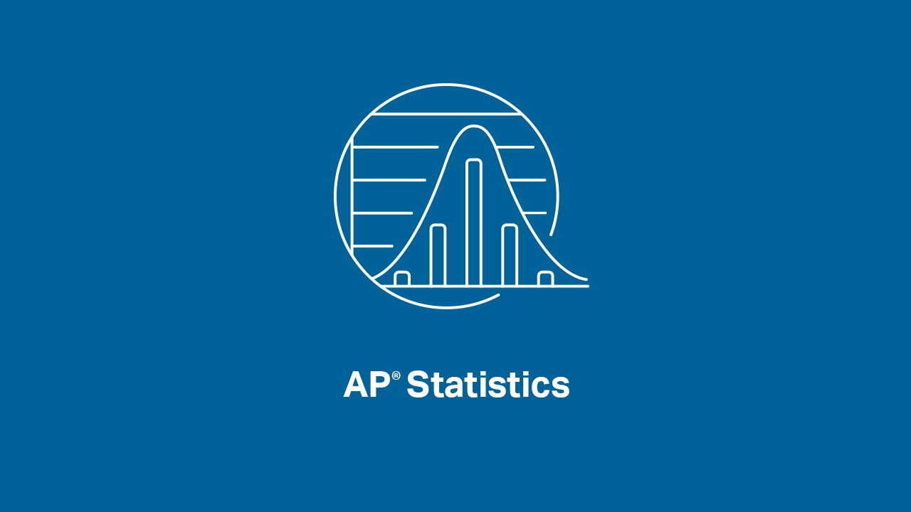

Slide 2
INTRODUCTIONS
Welcome to our first AP Statistics Virtual Instruction Session!!
Presenters:
Brendan Murphy
John Bapst Memorial High School
Bangor, ME
Luke Wilcox
East Kentwood High School
Kentwood, MI
www.statsmedic.com/youtube

Slide 3
HOMEWORK REVIEW

Slide 4
UPDATES FOR STUDENTS/TEACHERS
http://collegeboard.org/ap-covid19-updates
https://apstudents.collegeboard.org/coronavirus-updates

Slide 6
WHAT YOU NEED TO KNOW
CHI SQUARE
Just Hypothesis Tests – No Confidence Intervals
Just one formula for this whole unit
This formula is on the College Board Formula Sheet included on the AP Statistics Exam.
Chi-Square is a nonparametric test meaning we do not make any assumptions about the underlying distribution (i.e. a normal distribution).

Slide 7
WHAT YOU NEED TO KNOW
THREE DIFFERENT CHI SQUARE TESTS
Chi Square Test for Goodness of Fit (GOF)-We compare our data to a “model” (many times these models have percentages and we need to remember to convert these percentages to “counts”)
Chi Square Test for Homogeneity- Compare two different populations, one variable
Chi Square Test for Independence-We have one population and want to compare two or more variables
We need to calculate df’s (degrees of freedom similar to what you did with means).
We need to check conditions:
Data was randomly selected from the population
All expected values are at least 5
10% Condition: Our population is at least 10 times our sample size

Slide 8
Equations for both sample and population LSRL’s- Topic 9.2

Slide 9
WHAT YOU NEED TO KNOW- Confidence Intervals for the Slope of a Regression Model-Topic 9.2
Degrees of freedom df= (n-2)

Slide 10
WHAT YOU NEED TO KNOW- Setting up a Test for the Slope of a Regression Model- Topic 9.4

Slide 11
WHAT YOU NEED TO KNOW- Checking conditions for Confidence Intervals and Hypothesis Tests for the Slope of a Regression Model
CONDITIONS TO CHECK WHEN DOING CONFIDENCE INTERVALS AND HYPOTHESIS TESTS FOR SLOPE OF A REGRESSION MODEL:
Think LINER:
L= Linear, the relationship between x and y is linear (explanatory and response variables)
I= Independent, the individual observations are independent of each other, check the 10% condition
N= Normal, for any explanatory variable x the response variable y varies according to a normal distribution
E= Equal SD’s, the standard deviation of y is the same for all the values of x
R= Random, the data comes from a random sample of the population or a randomized experiment

Slide 12
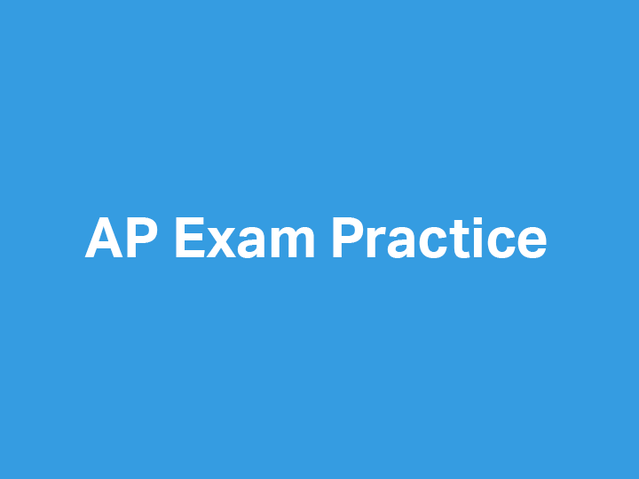

Slide 13
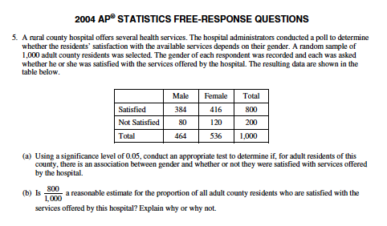
2004 AP Statistics Free Response #5

Slide 14
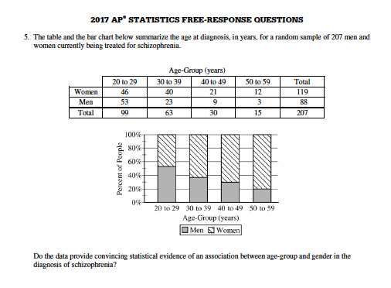
2017 AP Statistics Free Response #5

Slide 15
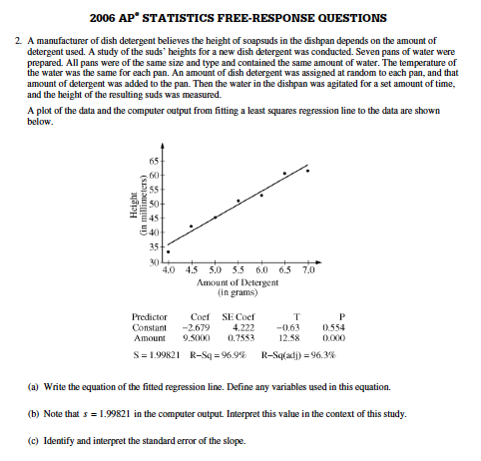
2006 AP Statistics FRQ #2

Slide 16
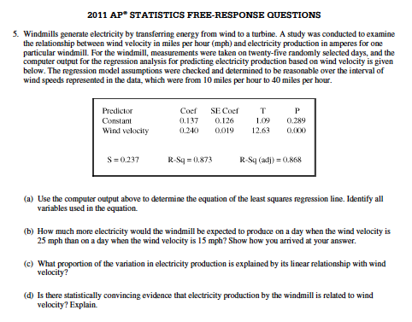
2011 AP Statistics FRQ #5

Slide 18
DEBRIEF AND SUMMARY
Hopefully by now you are feeling more comfortable with the Chi Square Tests and Inference for Regression
You should be able to select and use the correct Chi Square Test, construct CI’s or Hypothesis Tests for the Slope of a Regression Model
Similar to other Inference Tests/Procedures you should be able to write a clear/concise solution in context

Slide 19
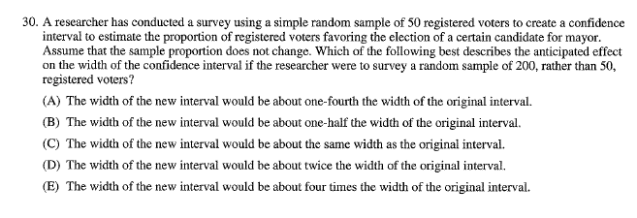
2007 MC #30 Homework Problem Friday 04/03

Slide 20
Device and Internet Access
We know that not all students have access to the internet or a device. We’re working on solutions to help students get what they need to show their best work. If you need mobile tools or connectivity or know someone who does, you can reach us directly to let us know.
cb.org/tech

