Slide 3
INTRODUCTIONS
Welcome to our first AP Statistics Virtual Instruction Session!!
Presenters:
Brendan Murphy
John Bapst Memorial High School
Bangor, ME
Luke Wilcox
East Kentwood High School
Kentwood, MI

Slide 4
SCHEDULE
Monday – Friday, 2:00 – 2:45 every day (EST)
March 25 – April 3: Units 8 & 9 in the College Board Course and Exam Description (CED)
Unit 8 – Inference for Categorical Data: CHI SQUARE
Unit 9 – Inference for Quantitative Data: SLOPES
These 2 units will NOT be on the AP Statistics Exam this year (2020 Exam)

Slide 5
SCHEDULE
Monday – Friday, 2:00 – 2:45 Every Day (EST)
April 6 – May 1: Review all major topics in AP Statistics curriculum that could be on this years AP Statistics exam.
Review test taking strategies for the AP Statistics Exam
45 minute test
All Free Response Questions
Assumption is that students will take exam at home on their computer, tablet, phone
This format is again just for the modified 2020 AP Stats Exam
Two exam administrations, one earlier and one later
More detailed information coming April 3, 2020

Slide 6
WHAT YOU NEED TO KNOW
CHI SQUARE
Just Hypothesis Tests – No Confidence Intervals
Just one formula for this whole unit
This formula is on the College Board Formula Sheet included in the AP Statistics Exam.
Chi-Square is a nonparametric test meaning we do not make any assumptions about the underlying distribution (i.e. a normal distribution).

Slide 8
WHAT YOU NEED TO KNOW
THREE DIFFERENT CHI SQUARE TESTS
Chi Square Test for Goodness of Fit (GOF)
Chi Square Test for Homogeneity
Chi Square Test for Independence
We need to calculate df’s (degrees of freedom similar to what you did with means).
We need to check conditions:
Data was randomly selected from the population
Large count: All expected values are at least 5
10%: Our population is at least 10 times our sample size

Slide 9
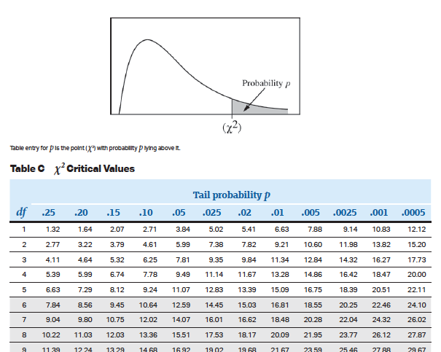
WHAT YOU NEED TO KNOW
A Chi Square table will be included in the formula sheet / table component of the AP Statistics Exam. Our calculators can “perform” these tests and students are expected to know how to access and use these tests on the AP Statistics Exam.

Slide 10
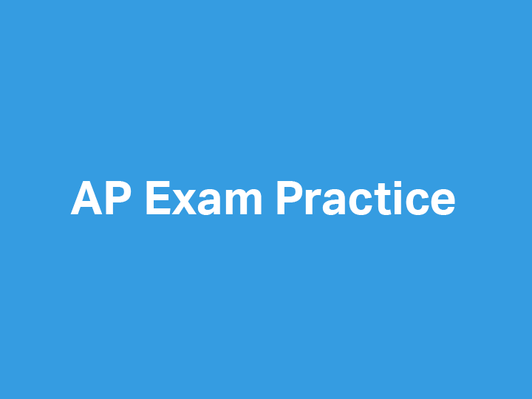

Slide 11
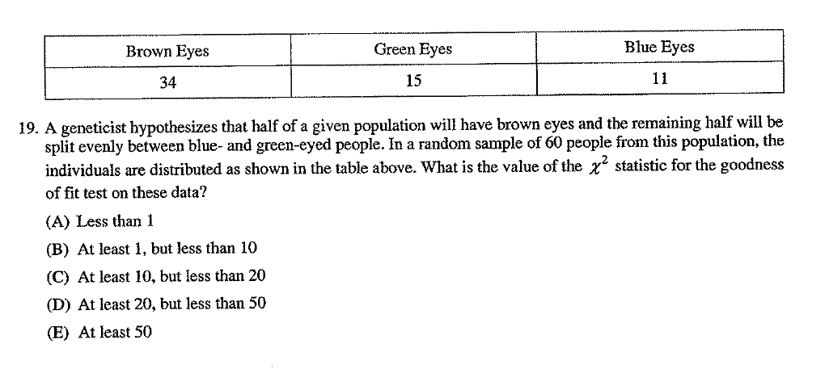
GUIDED PRACTICE
2002 Multiple Choice Question #19

Slide 12
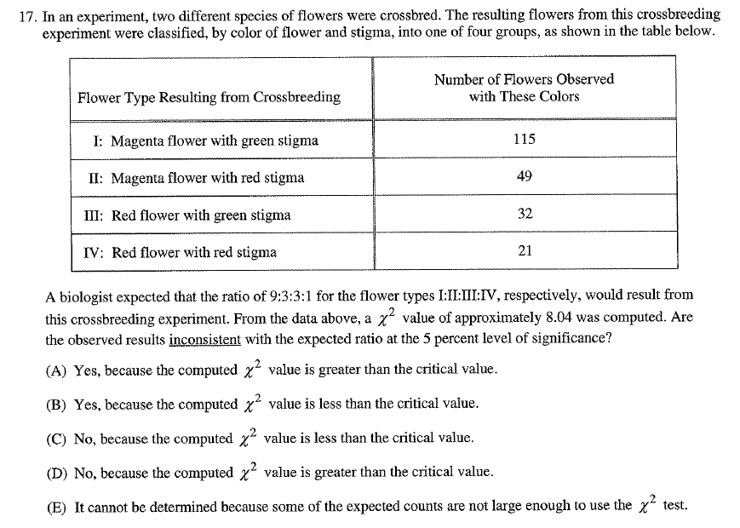
GUIDED PRACTICE
2007 Multiple Choice Question #17

Slide 13
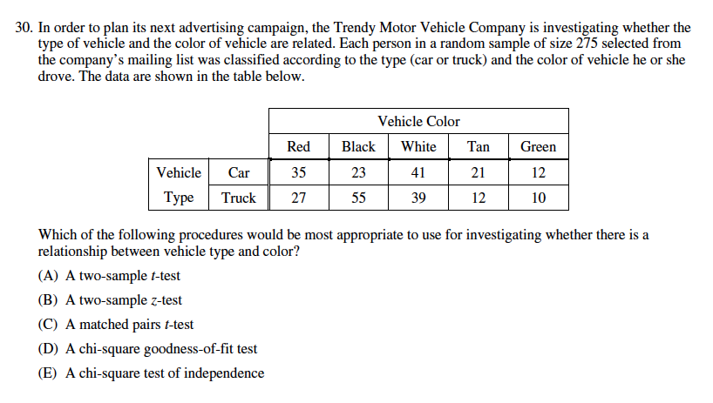
GUIDED PRACTICE-HW for Wednesday night 03/25
2012 Multiple Choice Question #30

Slide 15
DEBRIEF AND SUMMARY
Instructional Schedule
AP Statistics Exam Information
Overview of Chi Square Tests

