Slide 1
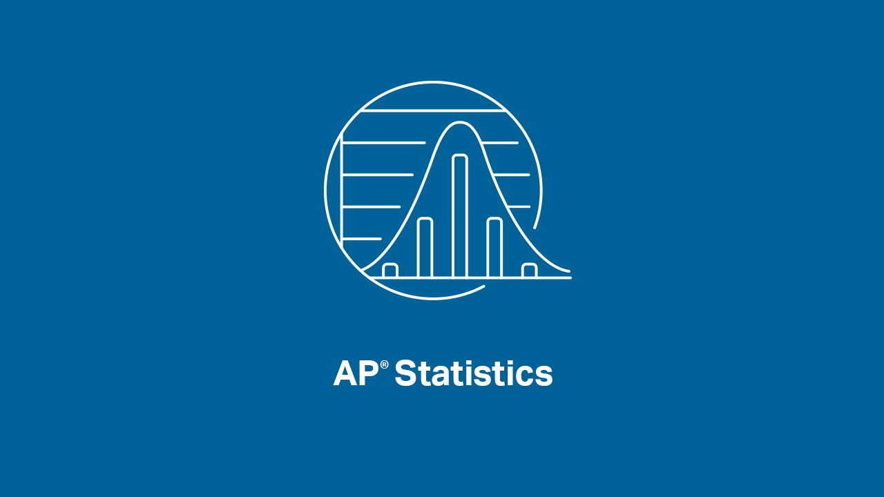

Slide 2
INTRODUCTIONS
Welcome to our first AP Statistics Virtual Instruction Session!!
Presenters:
Brendan Murphy
John Bapst Memorial High School
Bangor, ME
Luke Wilcox
East Kentwood High School
Kentwood, MI
www.statsmedic.com/youtube

Slide 3
HOMEWORK REVIEW

Slide 4
UPDATES FOR STUDENTS/TEACHERS
http://collegeboard.org/ap-covid19-updates
https://apstudents.collegeboard.org/coronavirus-updates

Slide 6
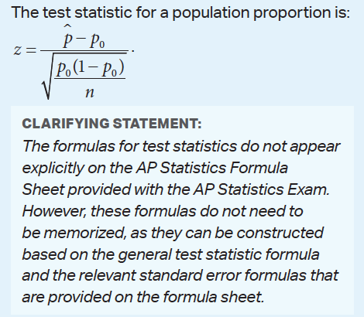
WHAT YOU NEED TO KNOW-TOPIC 6.5

Slide 7
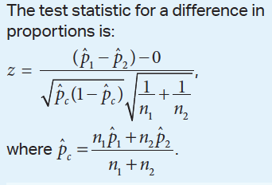
WHAT YOU NEED TO KNOW-TOPIC 6.11

Slide 8
WHAT YOU NEED TO KNOW
Don’t forget your ZAPTAX!!
Z= Z Table
A=Always
P=Proportions
T=T Table
A=Always
X= Means

Slide 9
WHAT YOU NEED TO KNOW
I always ask my students these four questions when doing Statistical Inference Problems:
Does this problem feel like a Confidence Interval or a Hypothesis Test?
Do we have one sample or two samples?
Are we dealing with proportions or means?
Do we need to read a Z Table or a T Table?
If we can answer these questions correctly if helps them to “name the test” and to get into the problem and hopefully solve it correctly.

Slide 10
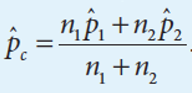
WHAT YOU NEED TO KNOW
Why do we need to calculate

Slide 11
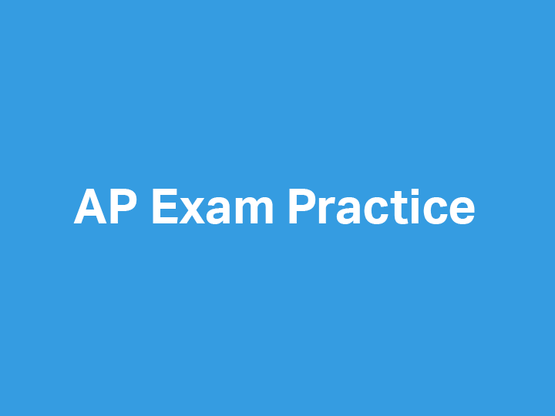

Slide 12
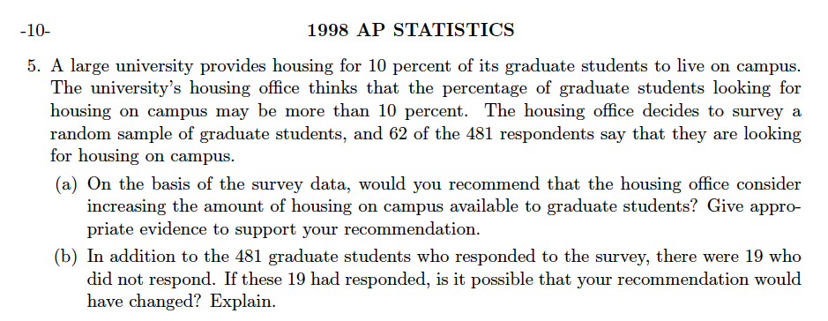
1998 AP Statistics Free Response #5

Slide 13
2012 AP Statistics Free Response #4

Slide 14
2015 AP Statistics FRQ #4

Slide 16
DEBRIEF AND SUMMARY
Hopefully by now you are feeling more comfortable with Confidence Intervals and Hypothesis Tests with Proportions (both one and two samples)
Similar to other Inference Tests/Procedures you should be able to write a clear/concise solution in context

Slide 17
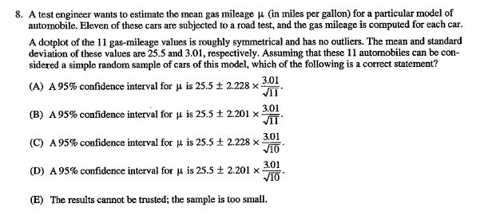
2002 MC #8 Homework Problem Tuesday 04/07

Slide 18
Device and Internet Access
We know that not all students have access to the internet or a device. We’re working on solutions to help students get what they need to show their best work. If you need mobile tools or connectivity or know someone who does, you can reach us directly to let us know.
cb.org/tech

