Slide 2
INTRODUCTIONS
Presenters:
Brendan Murphy
John Bapst Memorial High School
Bangor, ME
Luke Wilcox
East Kentwood High School
Kentwood, MI
www.statsmedic.com/youtube

Slide 3
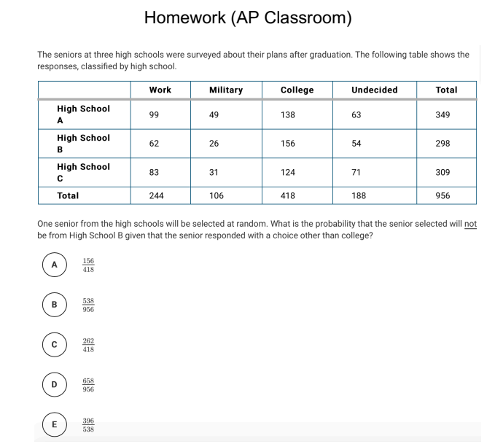
HOMEWORK REVIEW

Slide 4
UPDATES FOR STUDENTS/TEACHERS
http://collegeboard.org/ap-covid19-updates
https://apstudents.collegeboard.org/coronavirus-updates
https://apcoronavirusupdates.collegeboard.org/educators/course-schedule
Scroll down to Math And Science, click on AP Statistics, Expand All

Slide 6
WHAT YOU NEED TO KNOW-TOPIC 4.4

Slide 7
WHAT YOU NEED TO KNOW
Mutually exclusive events are NOT independent of each other

Slide 9
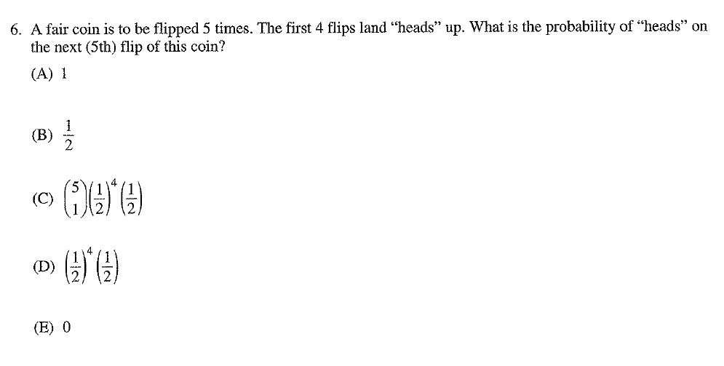
2007 AP Statistics Multiple Choice #6

Slide 10
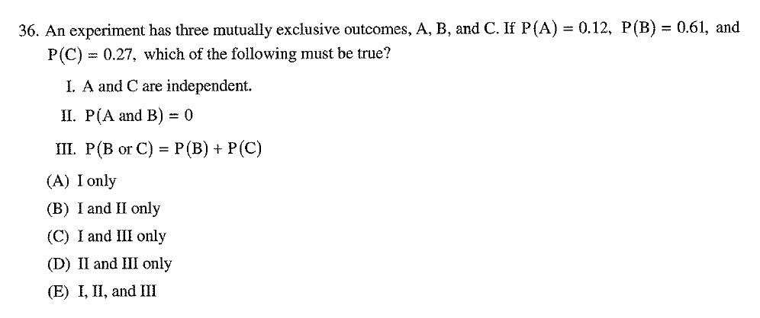
2007 AP Statistics Multiple Choice #36

Slide 11
2012 AP Statistics Multiple Choice #16

Slide 12
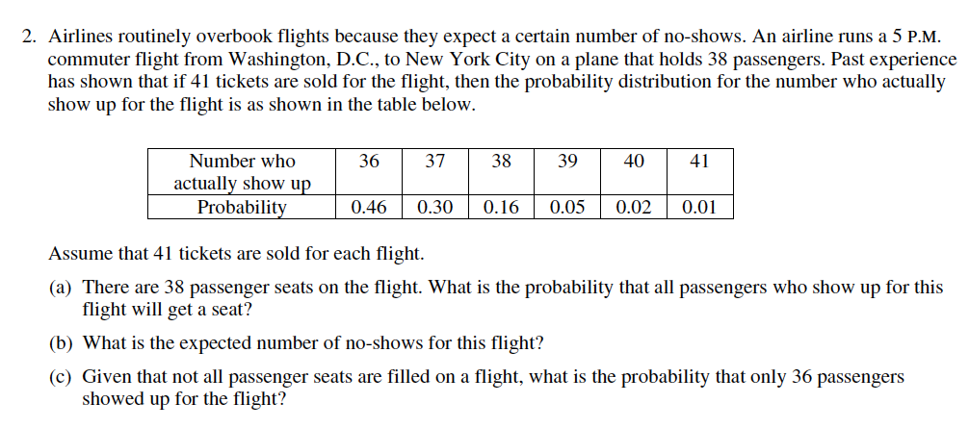
2002 Form B AP Statistics Free Response #2

Slide 13
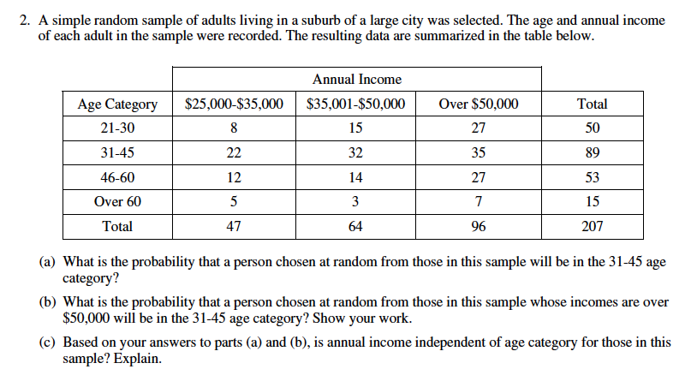
2003 Form B AP Statistics Free Response #2

Slide 14
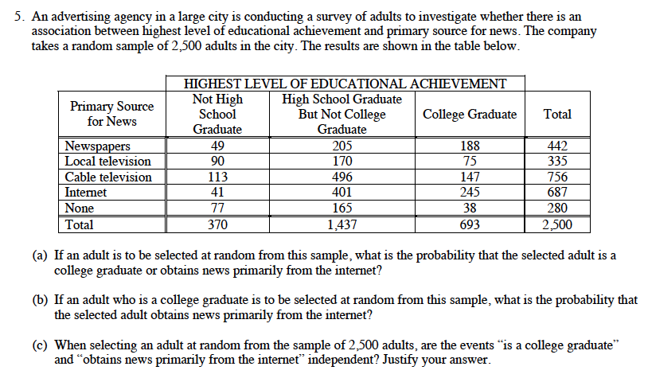
2010 Form B AP Statistics Free Response #5 (Modified)

Slide 16
DEBRIEF AND SUMMARY
Hopefully by now you are feeling more comfortable with solving different types of Probability questions
Similar to all problems in AP Statistics you should be able to write a clear/concise solution in context

Slide 17
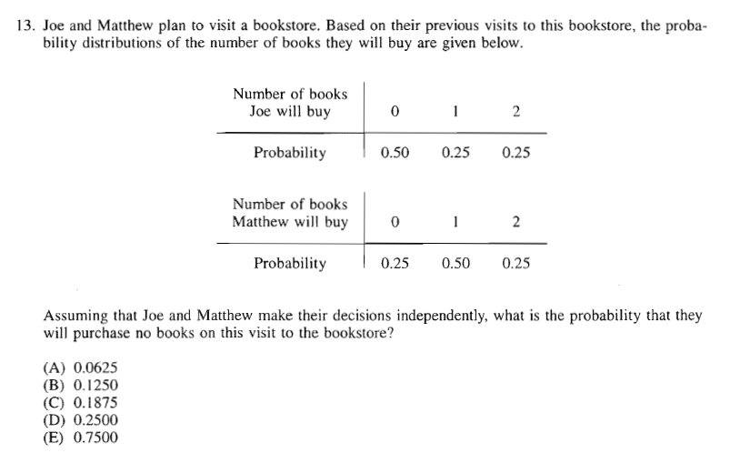
1997 Multiple Choice #13 Homework Problem Monday 04/20

Slide 18
Device and Internet Access
We know that not all students have access to the internet or a device. We’re working on solutions to help students get what they need to show their best work. If you need mobile tools or connectivity or know someone who does, you can reach us directly to let us know.
cb.org/tech

