Slide 1
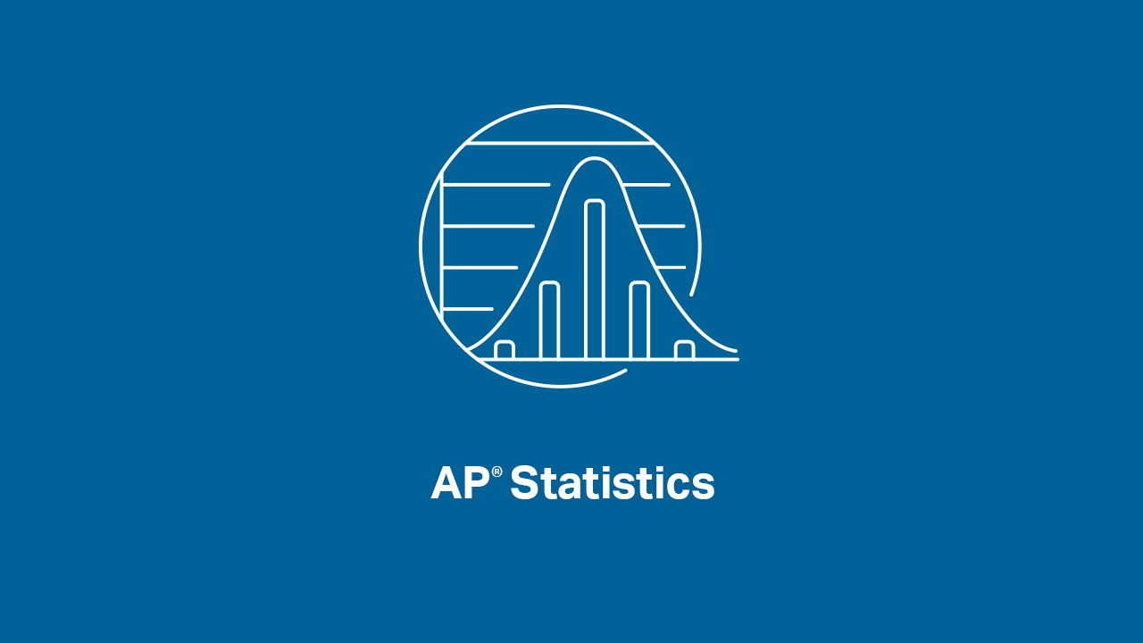

Slide 2
INTRODUCTIONS
Presenters:
Brendan Murphy
John Bapst Memorial High School
Bangor, ME
Luke Wilcox
East Kentwood High School
Kentwood, MI
www.statsmedic.com/youtube

Slide 3
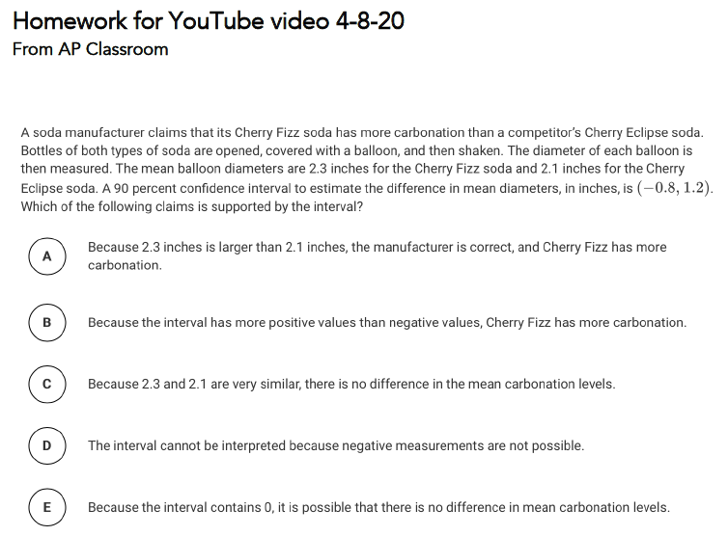
HOMEWORK REVIEW

Slide 4
UPDATES FOR STUDENTS/TEACHERS
http://collegeboard.org/ap-covid19-updates
https://apstudents.collegeboard.org/coronavirus-updates
https://apcoronavirusupdates.collegeboard.org/educators/course-schedule
Scroll down to Math And Science, click on AP Statistics, Expand All

Slide 6
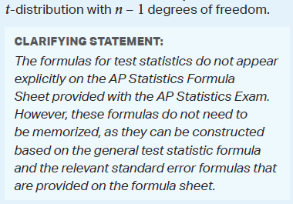
WHAT YOU NEED TO KNOW-TOPIC 7.5

Slide 7
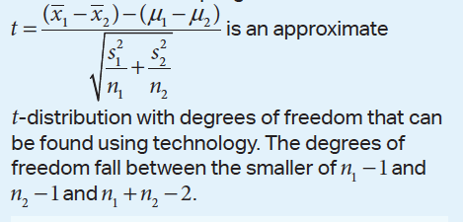
WHAT YOU NEED TO KNOW-TOPIC 7.9

Slide 8
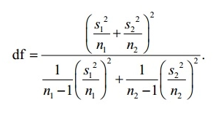
Satterthwaite Formula

Slide 9
WHAT YOU NEED TO KNOW
I always ask my students these four questions when doing Statistical Inference Problems:
Does this problem feel like a Confidence Interval or a Hypothesis Test?
Do we have one sample or two samples?
Are we dealing with proportions or means?
Do we need to read a Z Table or a T Table?
If we can answer these questions correctly if helps them to “name the test” and to get into the problem and hopefully solve it correctly.

Slide 10
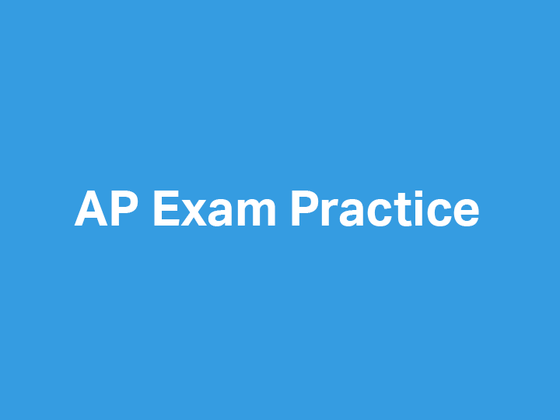

Slide 11
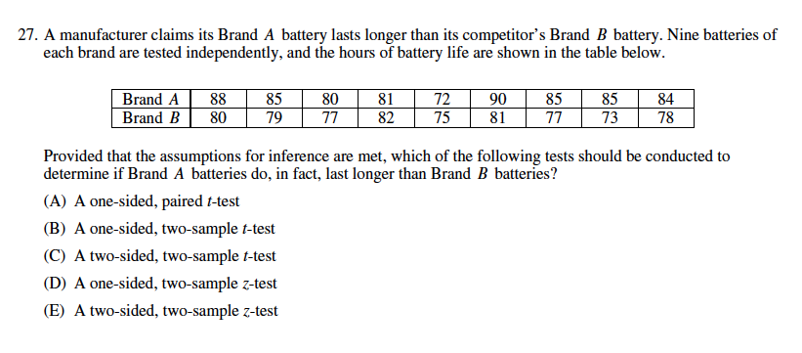
2012 AP Statistics Multiple Choice #27

Slide 12
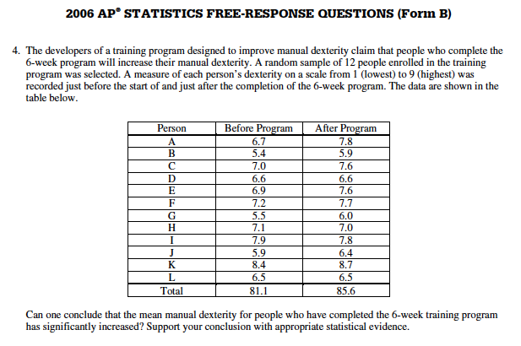
2006 Form B AP Statistics Free Response #4

Slide 13
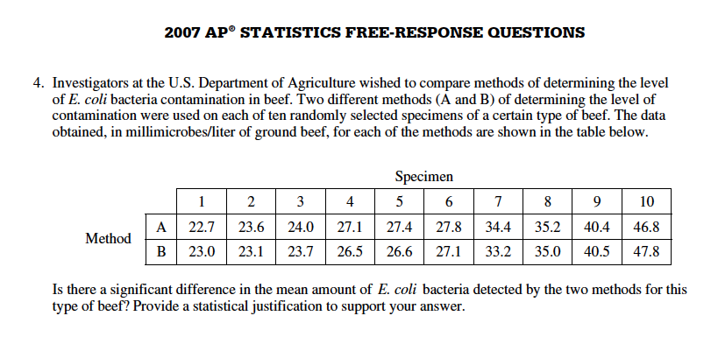
2007 AP Statistics FRQ #4

Slide 14
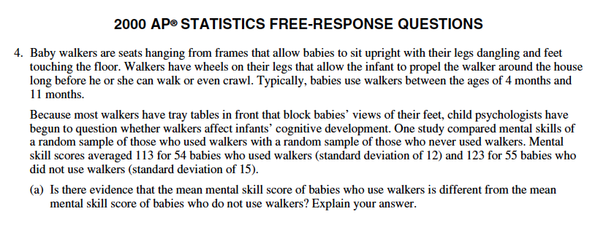
2007 AP Statistics FRQ #4

Slide 16
DEBRIEF AND SUMMARY
Hopefully by now you are feeling more comfortable with Confidence Intervals and Hypothesis Tests with Means (both one and two samples)
Similar to other Inference Tests/Procedures you should be able to write a clear/concise solution in context

Slide 17
2003 Modified Free Response #2 Homework Problem Thursday 04/09

Slide 18
Device and Internet Access
We know that not all students have access to the internet or a device. We’re working on solutions to help students get what they need to show their best work. If you need mobile tools or connectivity or know someone who does, you can reach us directly to let us know.
cb.org/tech

