Slide 2
INTRODUCTIONS
Presenters:
Brendan Murphy
John Bapst Memorial High School
Bangor, ME
Luke Wilcox
East Kentwood High School
Kentwood, MI
www.statsmedic.com/youtube

Slide 3
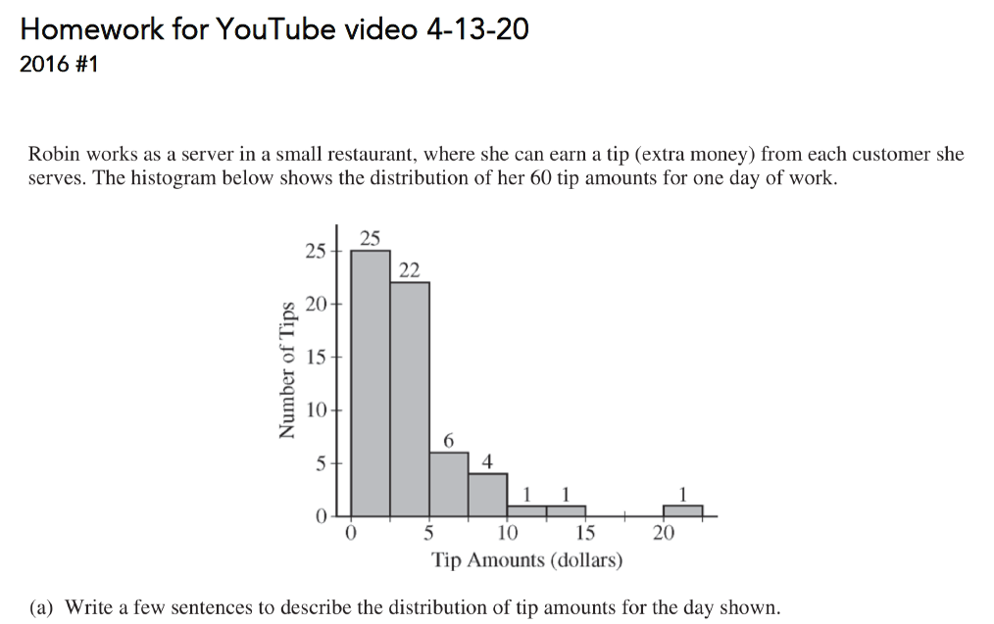
HOMEWORK REVIEW

Slide 4
UPDATES FOR STUDENTS/TEACHERS
http://collegeboard.org/ap-covid19-updates
https://apstudents.collegeboard.org/coronavirus-updates
https://apcoronavirusupdates.collegeboard.org/educators/course-schedule
Scroll down to Math And Science, click on AP Statistics, Expand All

Slide 6
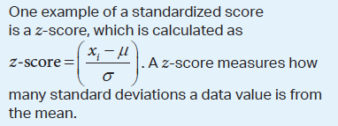
WHAT YOU NEED TO KNOW-TOPIC 1.10

Slide 8
2002 AP Statistics Multiple Choice #10

Slide 9
2007 AP Statistics Multiple Choice #3

Slide 10
2012 AP Statistics Multiple Choice #7

Slide 11
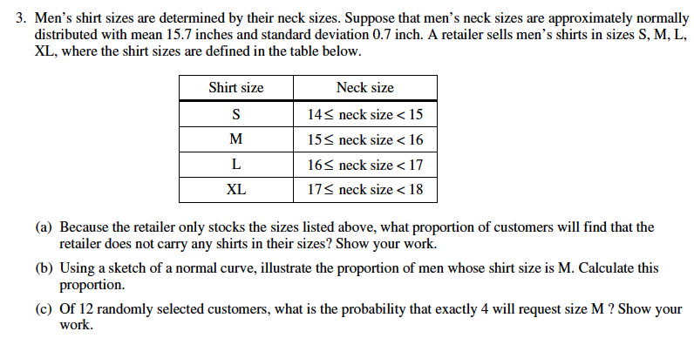
2003 AP Statistics FRQ #3

Slide 12
2004 Form B AP Statistics FRQ #3 (Modified)

Slide 13
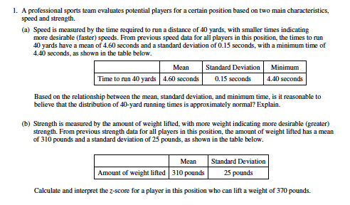
2011 AP Statistics FRQ #1 (Modified)

Slide 15
DEBRIEF AND SUMMARY
Hopefully by now you are feeling more comfortable with Calculating and Interpreting a Standardized Score (Z score)
Similar to all problems in AP Statistics you should be able to write a clear/concise solution in context

Slide 16
2002 Multiple Choice #31 Homework Problem Tuesday 04/14

Slide 17
Device and Internet Access
We know that not all students have access to the internet or a device. We’re working on solutions to help students get what they need to show their best work. If you need mobile tools or connectivity or know someone who does, you can reach us directly to let us know.
cb.org/tech

