Slide 1
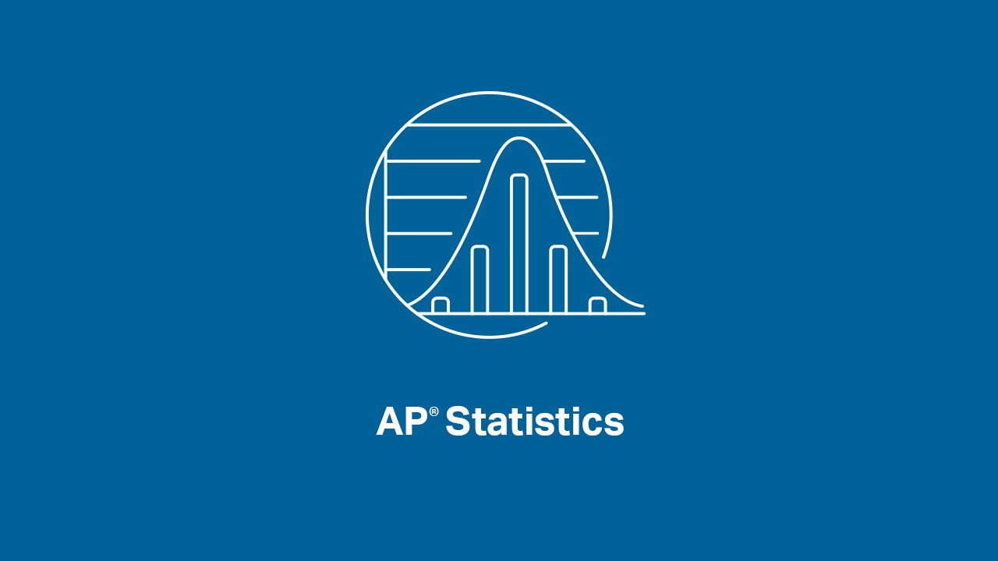

Slide 2
INTRODUCTIONS
Presenters:
Brendan Murphy
John Bapst Memorial High School
Bangor, ME
Luke Wilcox
East Kentwood High School
Kentwood, MI
www.statsmedic.com/youtube

Slide 3
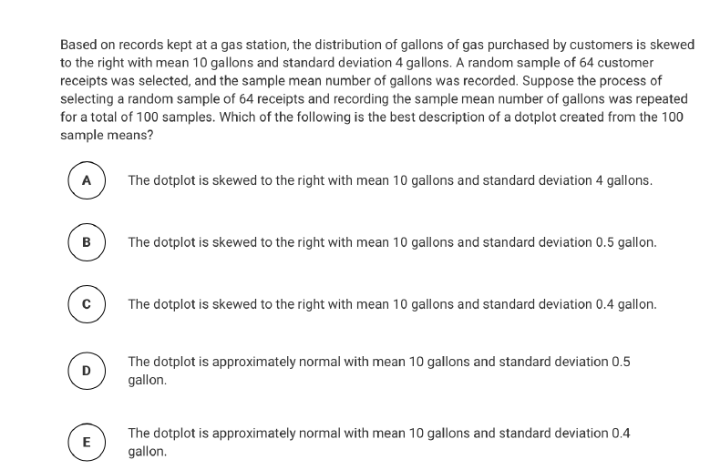
HOMEWORK REVIEW

Slide 4
UPDATES FOR STUDENTS/TEACHERS
http://collegeboard.org/ap-covid19-updates
https://apstudents.collegeboard.org/coronavirus-updates
https://apcoronavirusupdates.collegeboard.org/educators/course-schedule
Scroll down to Math And Science, click on AP Statistics, Expand All

Slide 6
WHAT YOU NEED TO KNOW-AP READING
About 700-800 High School and College Professors get together in June to read/grade all of your AP Exams
We’ve been Reading in Kansas City, MO for the last few years
The College Board likes to have a 50/50 split between HS and College folks
This is some of the best professional development that HS teachers can go to and many of us enjoy this week every year, we see our “Reading friends”, and we have a lot of fun. We work hard all day but there are plenty of fun things to do at night and it is one of the best weeks of the year for many of us! Maybe one of your teachers is a Reader and Luke and I have worked with them in the past?

Slide 7
WHAT YOU NEED TO KNOW-AP READING
During the Pre-Reading phase, the leadership team randomly samples student papers to see how the Scoring Guidelines are working and they then make minor revisions (after discussions and debates) as needed
Readers are trained for 3-4 hours on how to score a problem before actually grading any student papers
Readers are encouraged to work with their partner all week (usually HS teachers get paired with a College professor) to ask questions, resolve issues, and discuss the Scoring Guidelines. Readers MUST follow the Scoring Guidelines and their job is to consistently score all papers during the 7-day Reading schedule
Each grading room has two Table Leaders who act as quality control, making sure Readers are following the Scoring Guidelines. TL’s also answer questions from Readers on student responses that are perhaps a bit harder to score

Slide 8
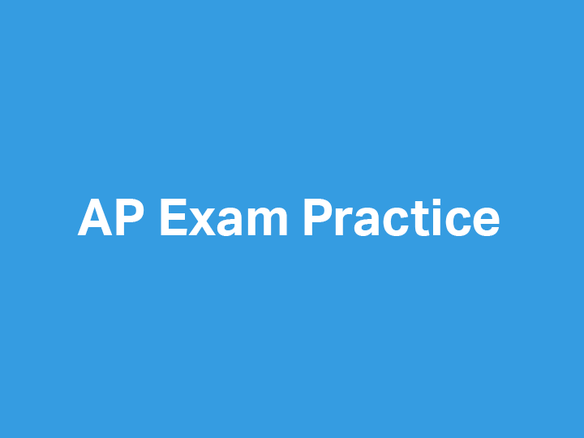

Slide 9
2005 AP Statistics – Free Response #4

Slide 10
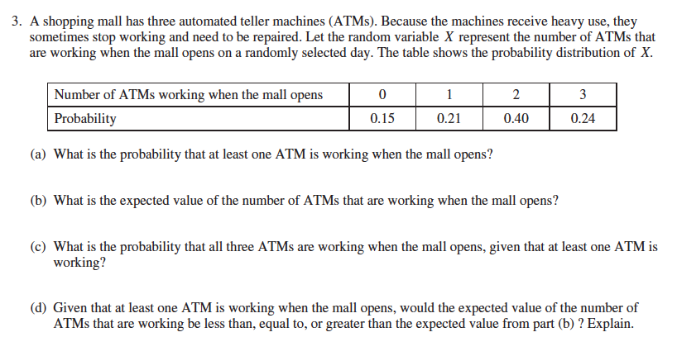
2015 - AP Statistics Free Response #3

Slide 12
DEBRIEF AND SUMMARY
Hopefully by now you are feeling more comfortable with how Scoring Guidelines are developed and how Readers are trained to grade/read your FRQ’s
Similar to all problems in AP Statistics you should be able to write a clear/concise solution in context

Slide 13
2012 Multiple Choice #18 Homework Problem Monday 04/27

Slide 14
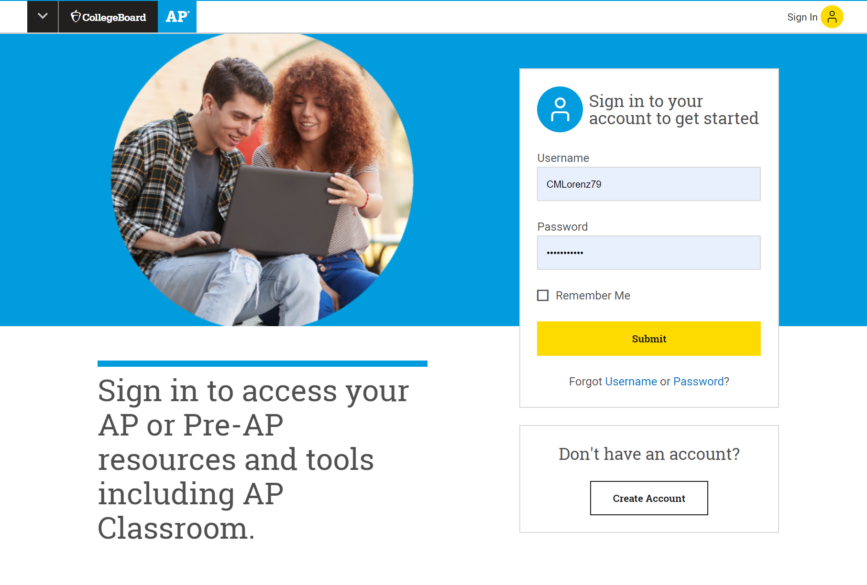
Log in at: myap.collegeboard.org

Slide 15
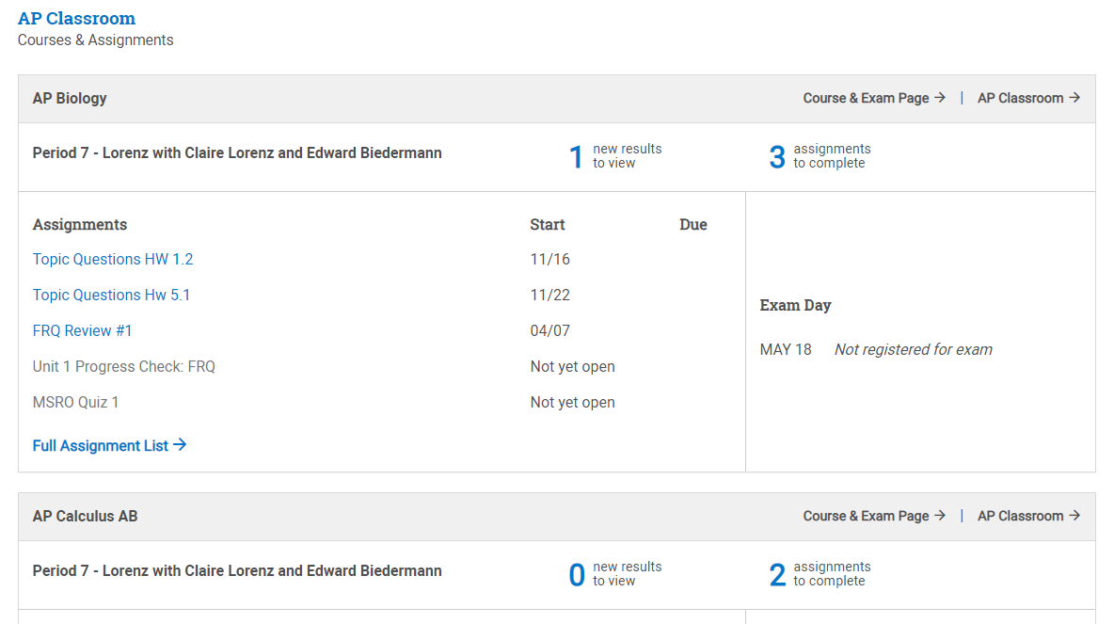
Scroll to see your classes and access AP Classroom
Click here

Slide 16
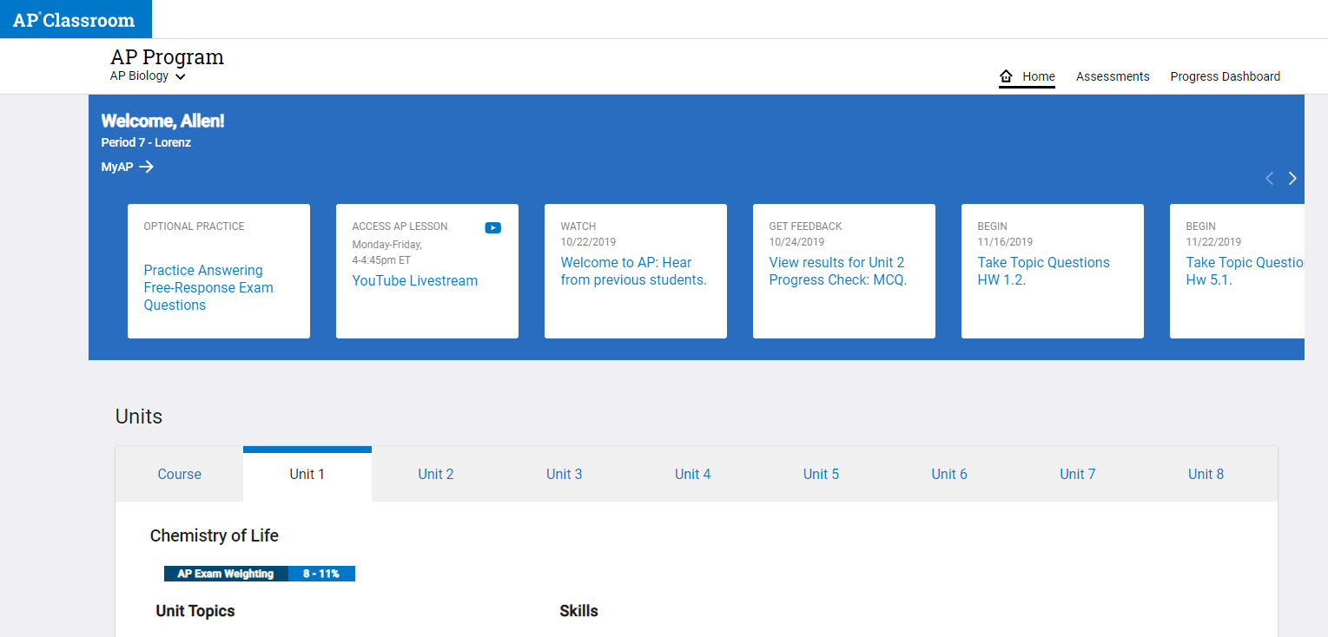
Click to access AP Live classes or Optional Practice
Click here AP Live classes on YouTube
Click here for Optional Student Practice

Slide 17
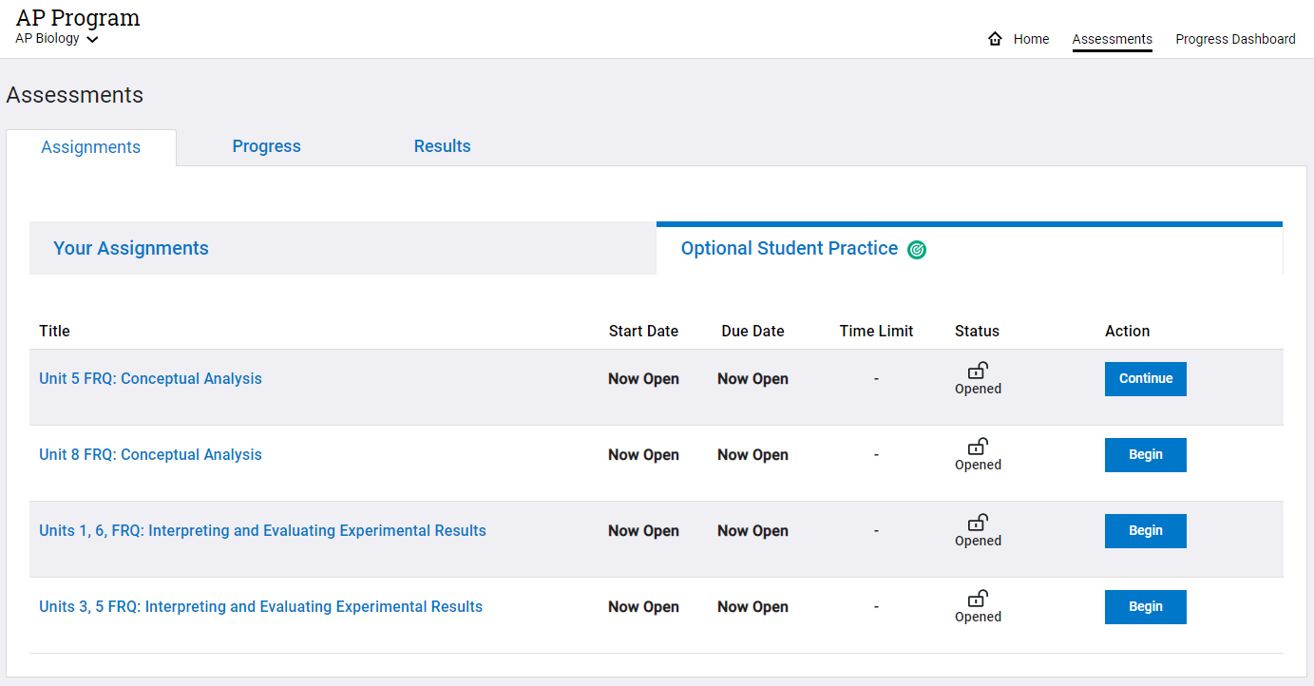
Click Begin or Continue to start a question
Click here
Click here

Slide 18
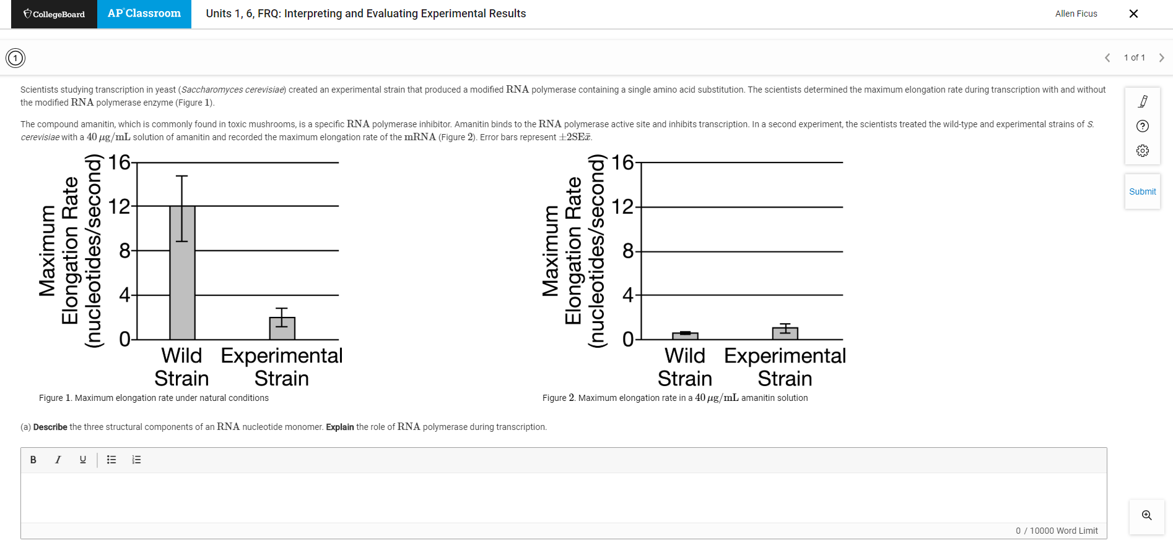
Type or upload your response. Then, click Submit.
Click submit when you are finished
Enter your response here

Slide 19
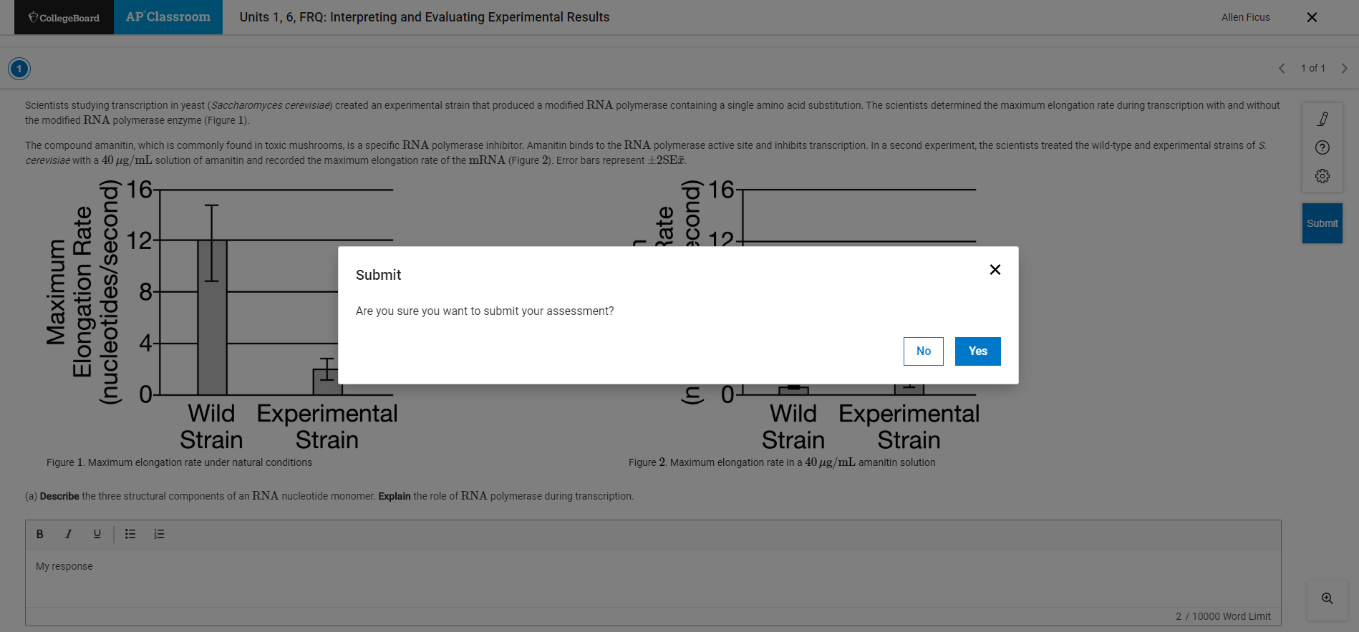
Click Yes to continue to submit your response

Slide 20
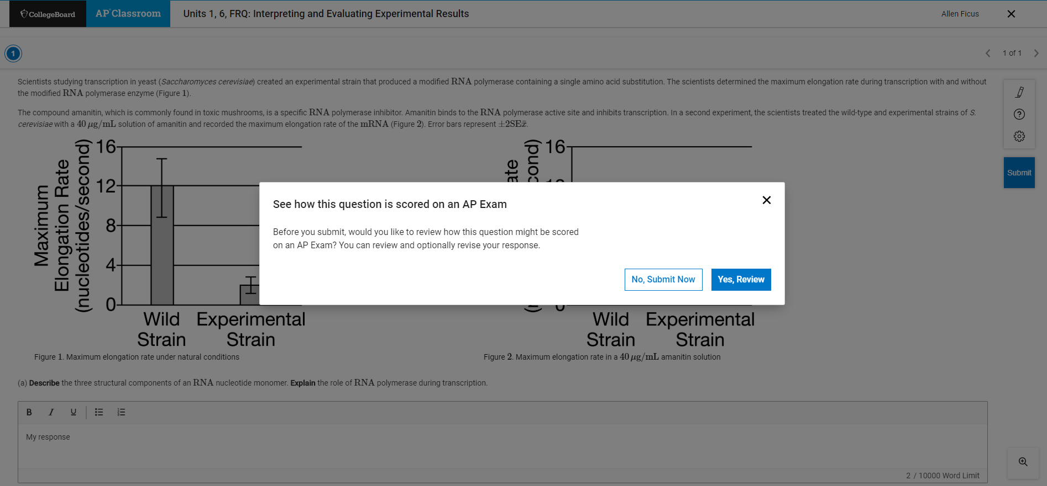
Click Yes, Review to see Scoring Guidelines

Slide 21
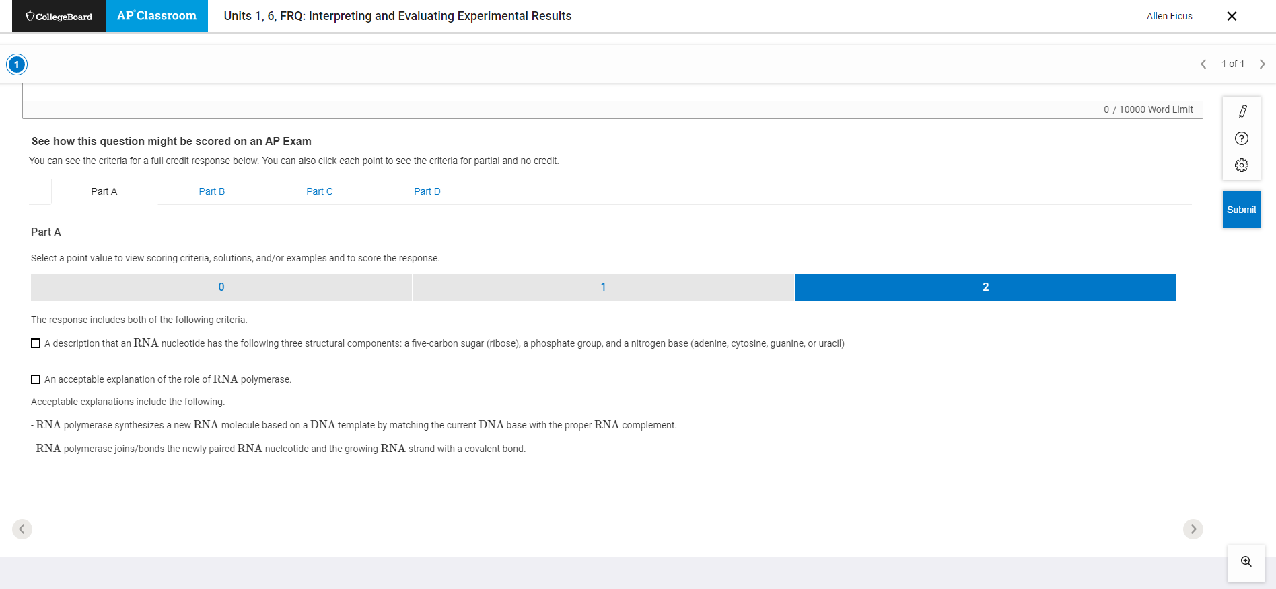
Scroll down to see Scoring Guidelines for each part
Review to see examples of what a response should include to earn the maximum number of points

Slide 22
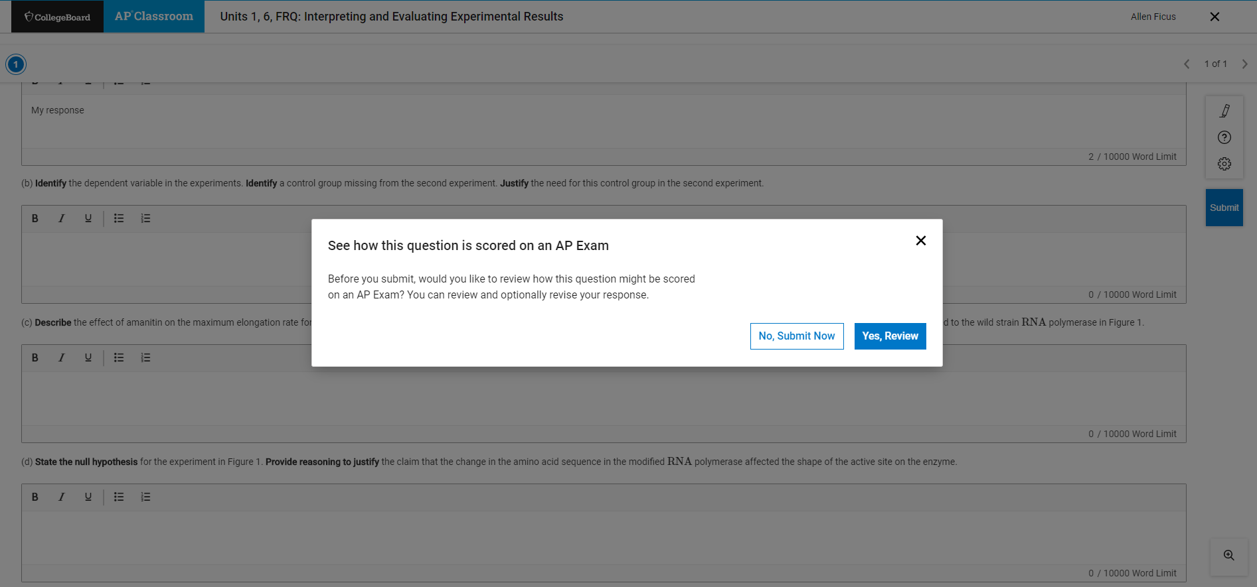
Revise, then click Submit & No, Submit Now to finish

