Slide 1
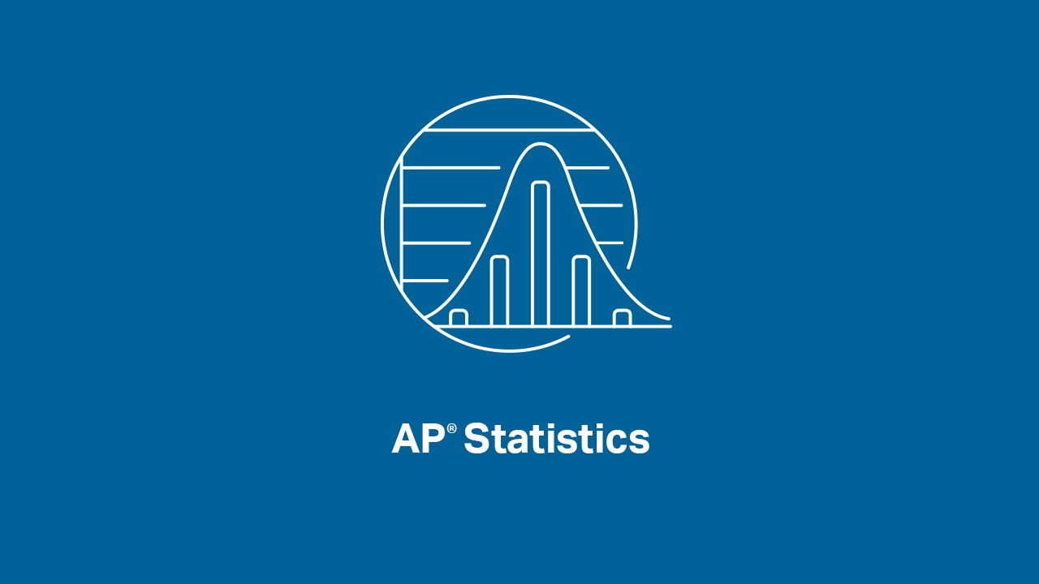

Slide 2
INTRODUCTIONS
Presenters:
Brendan Murphy
John Bapst Memorial High School
Bangor, ME
Luke Wilcox
East Kentwood High School
Kentwood, MI
www.statsmedic.com/youtube

Slide 3
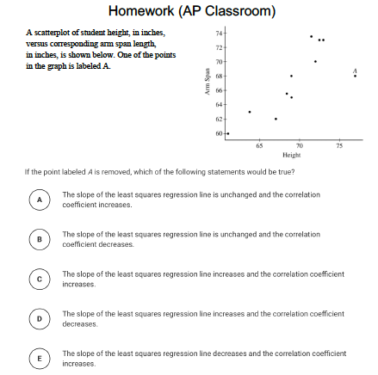
HOMEWORK REVIEW

Slide 4
UPDATES FOR STUDENTS/TEACHERS
http://collegeboard.org/ap-covid19-updates
https://apstudents.collegeboard.org/coronavirus-updates
https://apcoronavirusupdates.collegeboard.org/educators/course-schedule
Scroll down to Math And Science, click on AP Statistics, Expand All

Slide 6
WHAT YOU NEED TO KNOW
Correlation does not prove causation

Slide 7
WHAT YOU NEED TO KNOW-TOPIC 3.3
Random Sampling and Data Collection
Simple Random Sample (SRS)
Stratified Random Sample
Cluster Sampling
Systematic Random Sampling

Slide 8
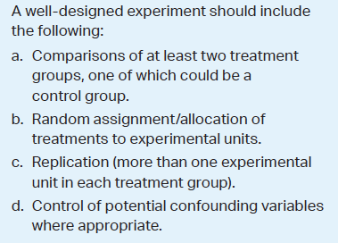
WHAT YOU NEED TO KNOW-TOPIC 3.5

Slide 9
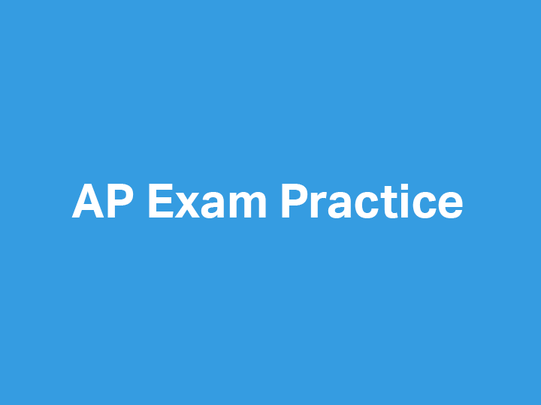

Slide 10
1999 AP Statistics Free Response #3

Slide 11
2002 AP Statistics Free Response #2

Slide 12
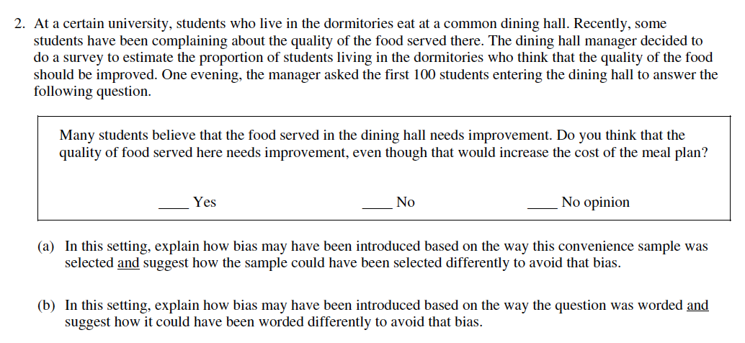
2004 Form B AP Statistics Free Response #2

Slide 13
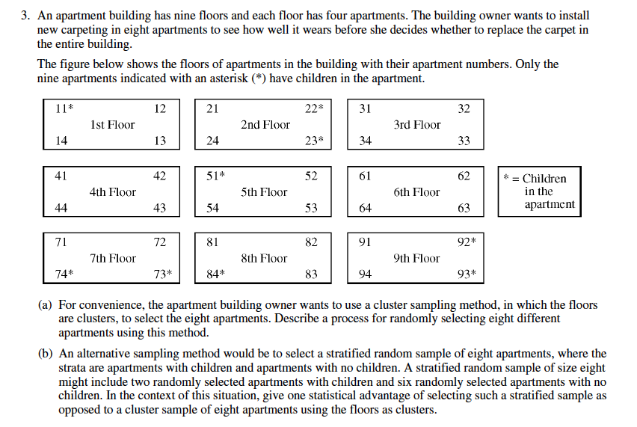
2011 AP Statistics Free Response #3

Slide 14
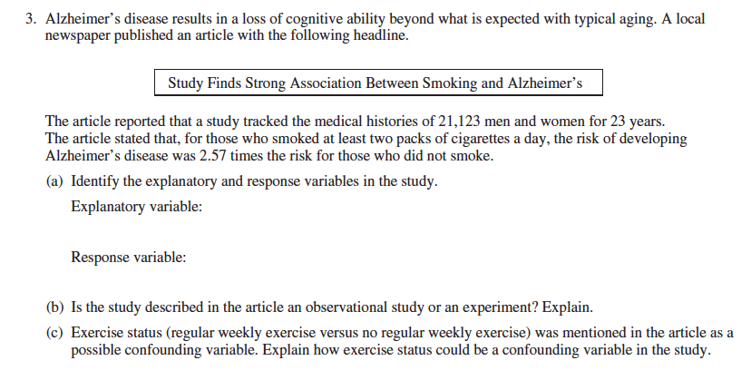
2016 AP Statistics Free Response #3

Slide 16
DEBRIEF AND SUMMARY
Hopefully by now you are feeling more comfortable with using the different Random Sampling techniques and designing an Experiment to show causation
Similar to all problems in AP Statistics you should be able to write a clear/concise solution in context

Slide 17
2012 Multiple Choice #10 Homework Problem Thursday 04/16

Slide 18
Device and Internet Access
We know that not all students have access to the internet or a device. We’re working on solutions to help students get what they need to show their best work. If you need mobile tools or connectivity or know someone who does, you can reach us directly to let us know.
cb.org/tech

