Slide 1
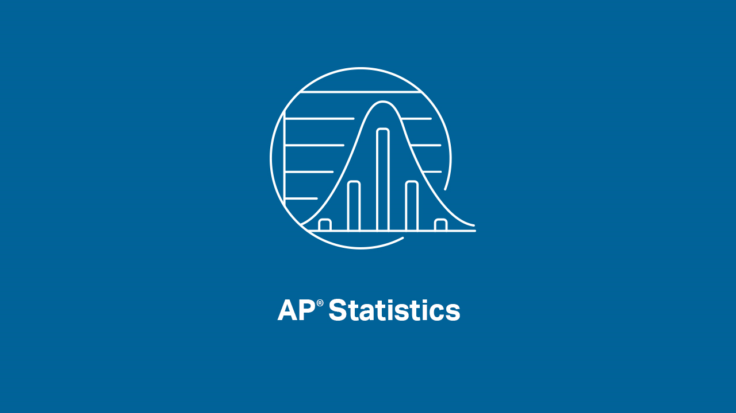

Slide 2


INTRODUCTIONS
Presenters:
Brendan Murphy
John Bapst Memorial High School
Bangor, ME
Luke Wilcox
East Kentwood High School
Kentwood, MI
www.statsmedic.com/youtube

Slide 3
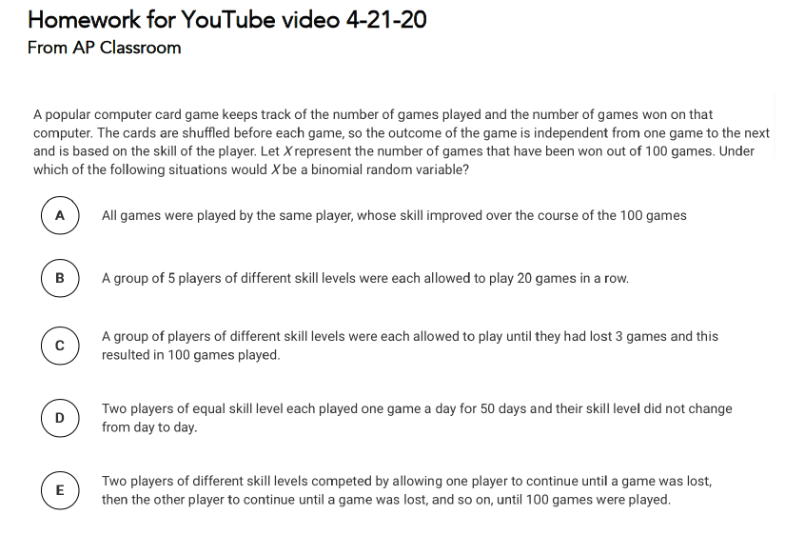
HOMEWORK REVIEW

Slide 4
UPDATES FOR STUDENTS/TEACHERS
http://collegeboard.org/ap-covid19-updates
https://apstudents.collegeboard.org/coronavirus-updates
https://apcoronavirusupdates.collegeboard.org/educators/course-schedule
Scroll down to Math And Science, click on AP Statistics, Expand All

Slide 5


Slide 6

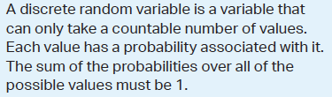
WHAT YOU NEED TO KNOW-TOPIC 4.7 –
Random Variables

Slide 7
WHAT YOU NEED TO KNOW
For two INDEPENDENT variables x and y we can add the variances, we cannot add the standard deviations.

Slide 8
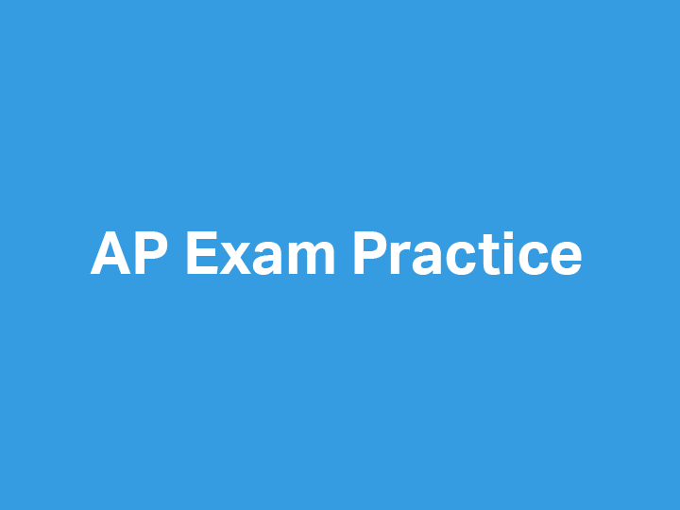

Slide 9
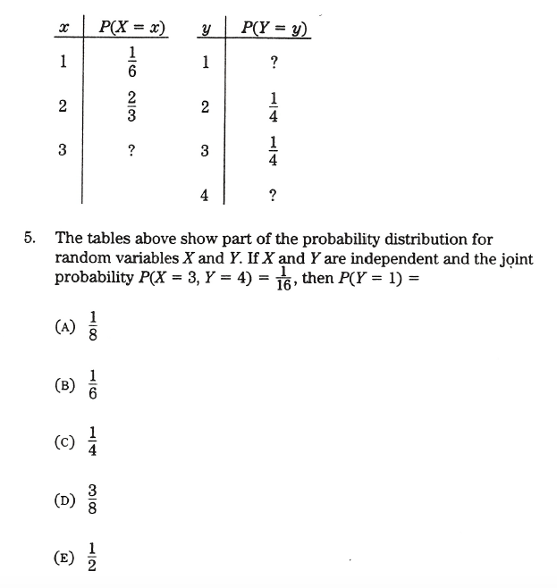
1997 Acorn Book - AP Statistics Multiple Choice #5

Slide 10
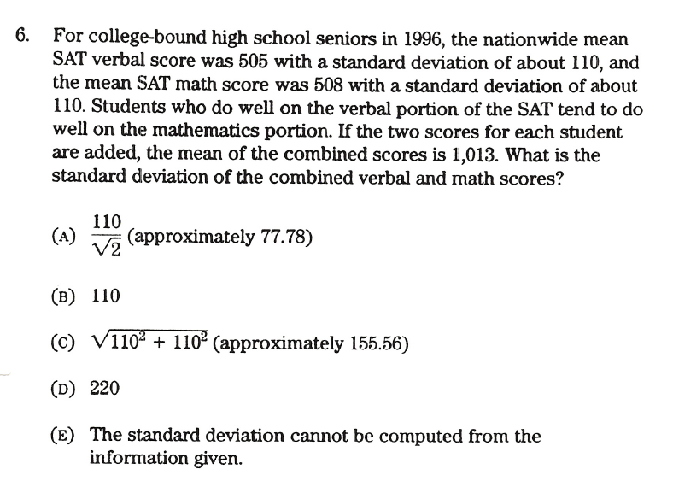
1997 Acorn Book - AP Statistics Multiple Choice #6

Slide 11
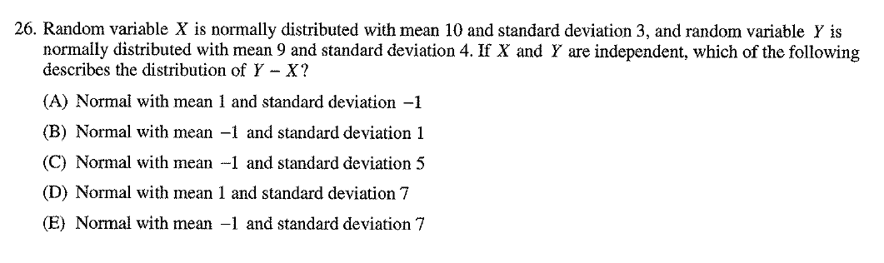
2007 AP Statistics Multiple Choice #26

Slide 12
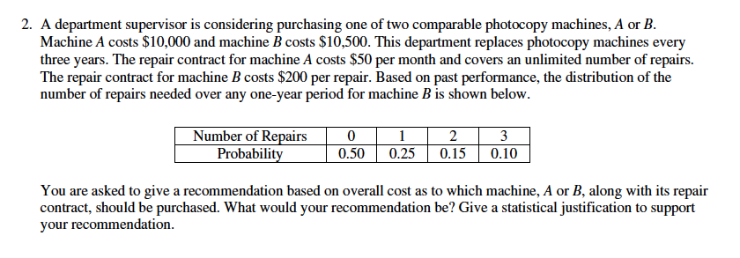
2001 AP Statistics Free Response #2

Slide 13
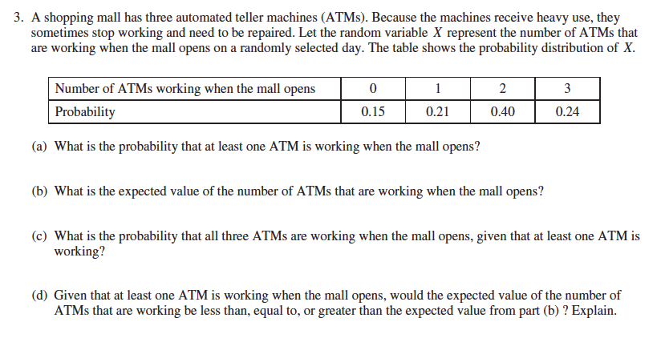
2015 AP Statistics Free Response #3

Slide 14
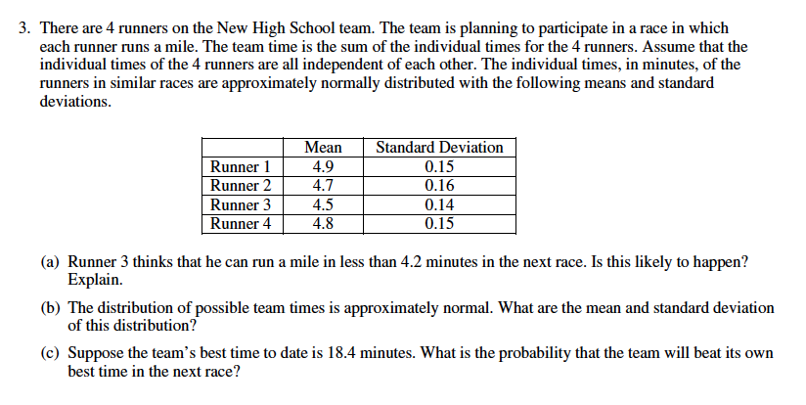
2002 AP Statistics Free Response #3

Slide 15


Slide 16
DEBRIEF AND SUMMARY
Hopefully by now you are feeling more comfortable with solving different types of Random Variable questions
Similar to all problems in AP Statistics you should be able to write a clear/concise solution in context

Slide 17
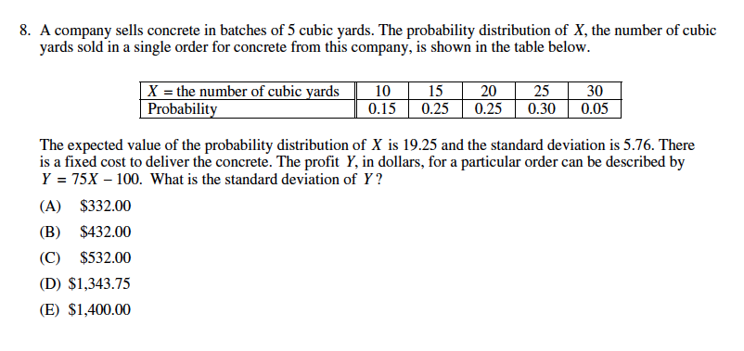
2012 Multiple Choice #8 Homework Problem
Wednesday 04/22

Slide 18

Device and Internet Access
We know that not all students have access to the internet or a device. We’re working on solutions to help students get what they need to show their best work. If you need mobile tools or connectivity or know someone who does, you can reach us directly to let us know.
cb.org/tech

Slide 19


