Slide 1
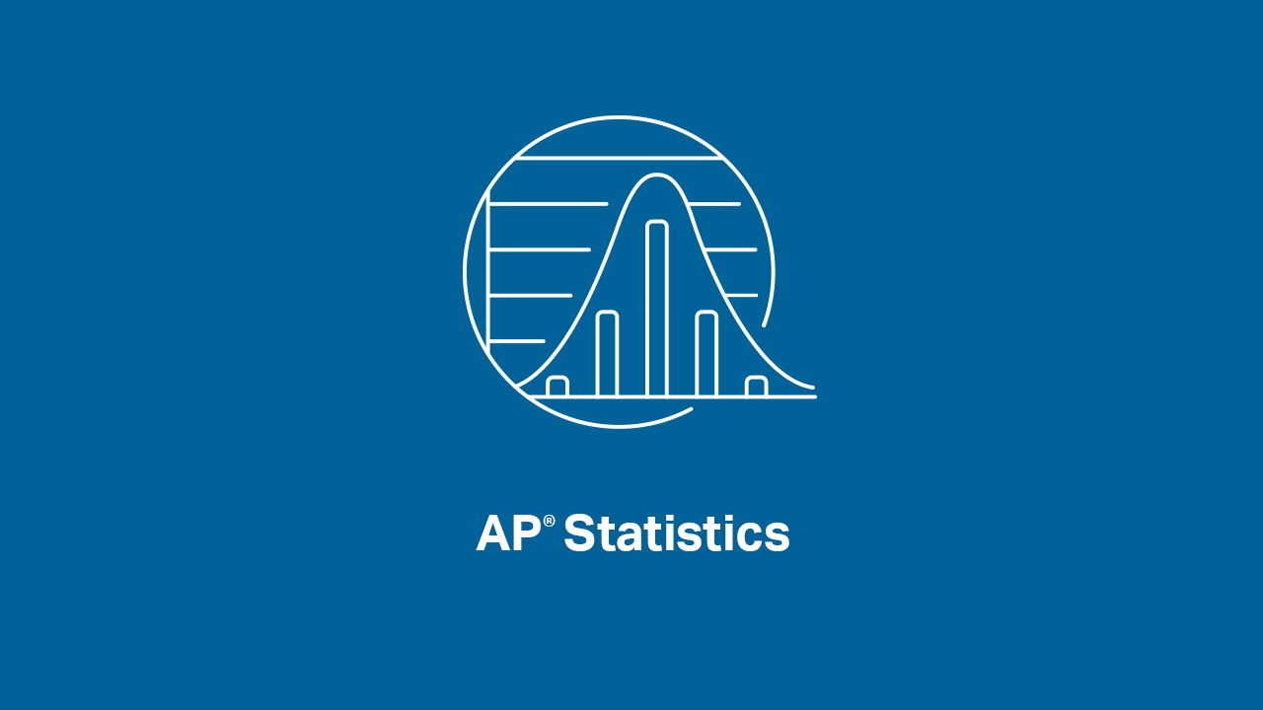

Slide 2
INTRODUCTIONS
Welcome to our last AP Statistics Virtual Instruction Session!!
Brendan Murphy
John Bapst Memorial High School
Bangor, ME
Luke Wilcox
East Kentwood High School
Kentwood, MI

Slide 3
Top 10 AP Exam Tips for AP Stats
1: Clearly communicate your understanding
You can communicate your understanding using formulas, calculations, or words.
A correct answers with no work most often will not earn full credit.
Write what you need and then be done.

Slide 4
Top 10 AP Exam Tips for AP Stats
2: Always include context in your answers
Describe a distribution.
Describe the relationship between two variables.
“IT” is inappropriate language

Slide 5
Top 10 AP Exam Tips for AP Stats
3: Be specific in your language and vocabulary
Some terms have very specific statistical meaning: significant, accurate, skewed, biased
Stratified versus blocking
Precise versus accurate
Population distribution versus sampling distribution vs. sample distribution

Slide 6
Top 10 AP Exam Tips for AP Stats
4: Use appropriate notation
Know the difference between a statistic (sample) and a parameter (population)
Be sure to define your parameters.
z versus t

Slide 7
Top 10 AP Exam Tips for AP Stats
5: Prepare your workspace
Print out the new 2020 Formula Sheet and Tables
Have your charged calculator ready
Study in the place where you will take the exam

Slide 8
Top 10 AP Exam Tips for AP Stats
6: Manage your time
Login 30 minutes early
FRQ #1 is 25 minutes with 5 minutes to upload, FRQ #2 is 15 minutes with 5 minutes to upload.
Don’t spend too much time on one part.
Watch the clock/timer on the exam, when it turns red you have 5 minutes to upload your answer

Slide 9
Top 10 AP Exam Tips for AP Stats
7: Don’t leave anything blank
Don’t stress if you struggle on one or two parts. You can still earn a 5.
Partial answers earn partial credit.
No penalty for guessing.
If you are stuck and one part and need the answer for the next part, make up a reasonable answer.
Attempt all parts of each problem, you might be able to do parts c,d for example even if you did not like/understand parts a,b.

Slide 10
Top 10 AP Exam Tips for AP Stats
8: Know the formula sheet
New for 2020: Geometric random variables, standard deviation and standard error clearly identified
Be able to quickly find what you need
Know which table is used when. Table A (sometimes called a Z Table), Table B (sometimes called a T Table)

Slide 11
Top 10 AP Exam Tips for AP Stats
9: Know your inference
Means or proportions?
One sample or two samples?
Confidence interval or significances test?
Paired t-test or two sample t test?
Z Table or a T Table?

Slide 12
Top 10 AP Exam Tips for AP Stats
10: Be confident! Be ready!
Take a Practice Exam to increase confidence.
You have done the work (especially if you have been with us on YouTube)!
See next slide for the 5 Steps to get ready for the AP Exams.
Look at this exam as a way to show how much you have learned all year, you have already done all the hard work.

Slide 13
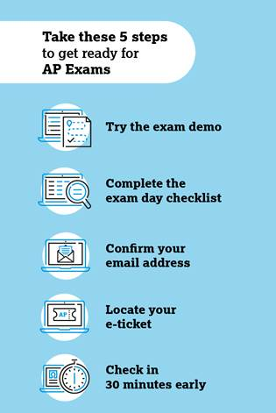
Be sure to do these 5 things
before your exam.
cb.org/ap2020getready

Slide 14
2020 AP Exam Predictions
FRQ #1 will have 5 - 6 parts. FRQ #2 will have 4 - 5 parts.
The two FRQs will cover all the units in the CED (Units 1 – 7).
One FRQ will use means and one FRQ will use proportions.
One FRQ will include a confidence interval and one FRQ will include a significance test.
One FRQ will be a 1-sample scenario and one FRQ will be a 2-sample scenario.

Slide 15
2020 AP Exam Predictions
What topic would you really like to see on the AP Stats exam this year?

Slide 16
YouTube Live Reflection
What is one memory that you will take away from this whole YouTube Live experience?

Slide 17
GOOD LUCK AP STATS STUDENTS!
We have really enjoyed the opportunity to be part of your AP Stats journey for this crazy school year.
Know that Mr. Wilcox and Mr. Murphy are rooting for you on the AP Exam!

